Slide 1



MET: A Magneto Inductive Sensing Based Electric Toothbrushing Monitoring System
Hua Huang
hhuang80@ucmerced.edu
Stony Brook University
University of California, Merced*
Shan Lin
shan.x.lin@stonybrook.edu
Stony Brook University
* Current Affiliation
Notes:
Hello everyone. Today I will Introduce our work on Electric toothbrushing monitoring with magnetic inductive sensing.

Slide 2






The Popularity of Electric Toothbrushes
Number of Electric Toothbrush Users in the USA [1]
[1] U.S. Census data and Simmons National Consumer Survey (NHCS), 2019
Notes:
Toothbrushing is the crucial habit for a user to maintain dental health. Nowadays, electric toothbrushes are gaining popularity, and they are being used by over one hundred and twenty million Americans in .

Slide 3
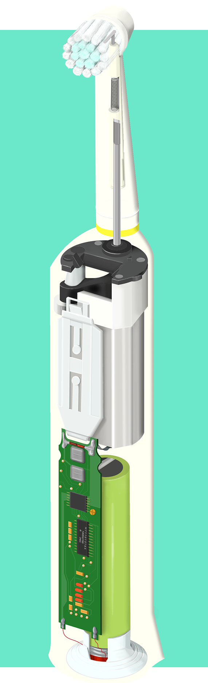
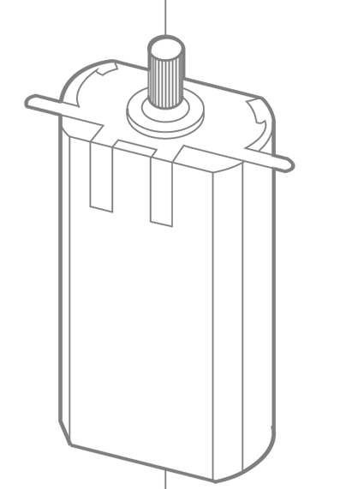
Electric Toothbrush
Mechanism
Convert motor power into brushing movements
Usage
Let the toothbrush do the brushing
Compliance Challenges
Uneven Coverage [1]
Aggressive movements [2]
[1] U. Saxer et al, “New studies on estimated and actual toothbrushing times and dentifrice use.” The Journal of clinical dentistry, 1997
[2] C. Ganss et al, “Tooth brushing habits in uninstructed adults—frequency, technique, duration and force,” Clinical Oral Investigations, 2008
Notes:
There are many designs of electric toothbrushes. Many of them convert the high-speed rotary motions of the electric motors to the back-and-forth brushing movements the brush heads that clean the teeth effectively.
To use an electric toothbrush, the manufacturer recommends the following guideline. We need to gently place the toothbrush on the teeth, and allow the toothbrush to do the brushing.
although the power toothbrushes are easy to use, many users are still not getting the desired dental cleaning results. The first challenge is to ensure full and even brushing coverage. It is widely recommended that each toothbrushing session should be 2 minutes, and the brushing time should be evenly distributed among different tooth surfaces. However, in practice, due to the uneven time distribution, some surfaces are receiving too much brushing, while others are not receiving enough.
The second challenge is to ensure correct brushing techniques. Common incorrect toothbrushing techniques, such as scrubbing motions, are ineffective in removing dental plaques, and can create excessive abrasions. However, a study shows that 75% of the participants fail to brush using the correct techniques.

Slide 4

Existing Toothbrushing Monitoring Technologies
Camera-based (Oral B) [1]
The cheek causes visibility obstruction
Microphone-based [2]
Cannot track orientations
Motion Sensing-based (Kolibree) [3]
Motor vibration generates severe drifting errors
[1] YC Chang et al. Playful toothbrush: ubicomp technology for teaching tooth brushing to kindergarten children. CHI '08
[2] Ouyang, Zhenchao et al. "An asymmetrical acoustic field detection system for daily tooth brushing monitoring." In GLOBECOM. IEEE, 2017.
[3] C. Ganss, et al, “Tooth brushing habits in uninstructed adults—frequency, technique, duration and force,” Clinical Oral Investigations, 2008
Notes:
There exists A few toothbrushing monitoring systems. There are camera based systems, which recognize toothbrushing surface by analyzing the video footage of a smartphone camera.
However, since our cheeks obstruct the toothbrushes from time to time, such systems have limited monitoring accuracy and granularity.
There are systems that differentiate the brushing surfaces by analyzing the brushing sounds. However, such systems cannot differentiate several surfaces, such as the upper and the lower chewing surfaces, because they cannot track the toothbrush orientations.
There are motion sensor-based systems. These systems use the inertia sensors inside the toothbrush to recognize the brushing surfaces. However, as demonstrated in our experiments, these systems suffer from large drifting errors because of the vibrations generated by the electric motor. As a result, they have low monitoring accuracy.

Slide 5
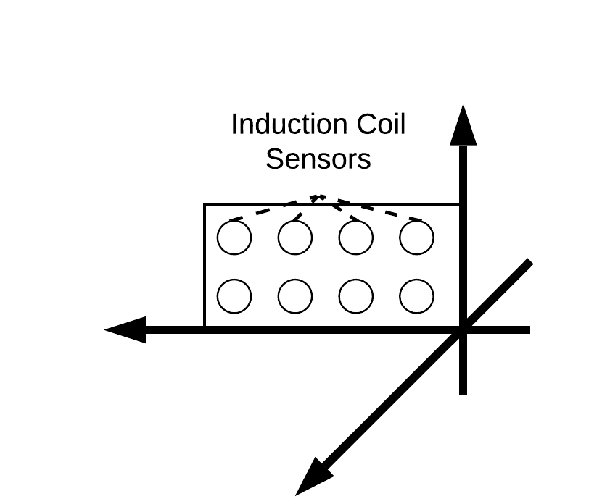
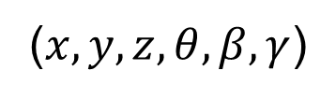
A New Sensing Modality for Toothbrushing Monitoring
Key observation: The magnetic field reflects motor position
Motivated the first motor tracking system based on magnetic sensing
($x,y,z,θ,β,γ$)
Notes:
To overcome these limitations, we began to explore alternative solutions
Here is our key observation. When we place A magnetic sensor near the electric motor of the toothbrush, it can detect a stable time-varying magnetic field. The motor movements are reflected by the magnetic sensing results. Furthermore, the magnetic field is not influenced by the user’s body.
Motivated by this observation, we initiated efforts in developing the first system uses magnetic sensing to track the motions of an electric motor

Slide 6
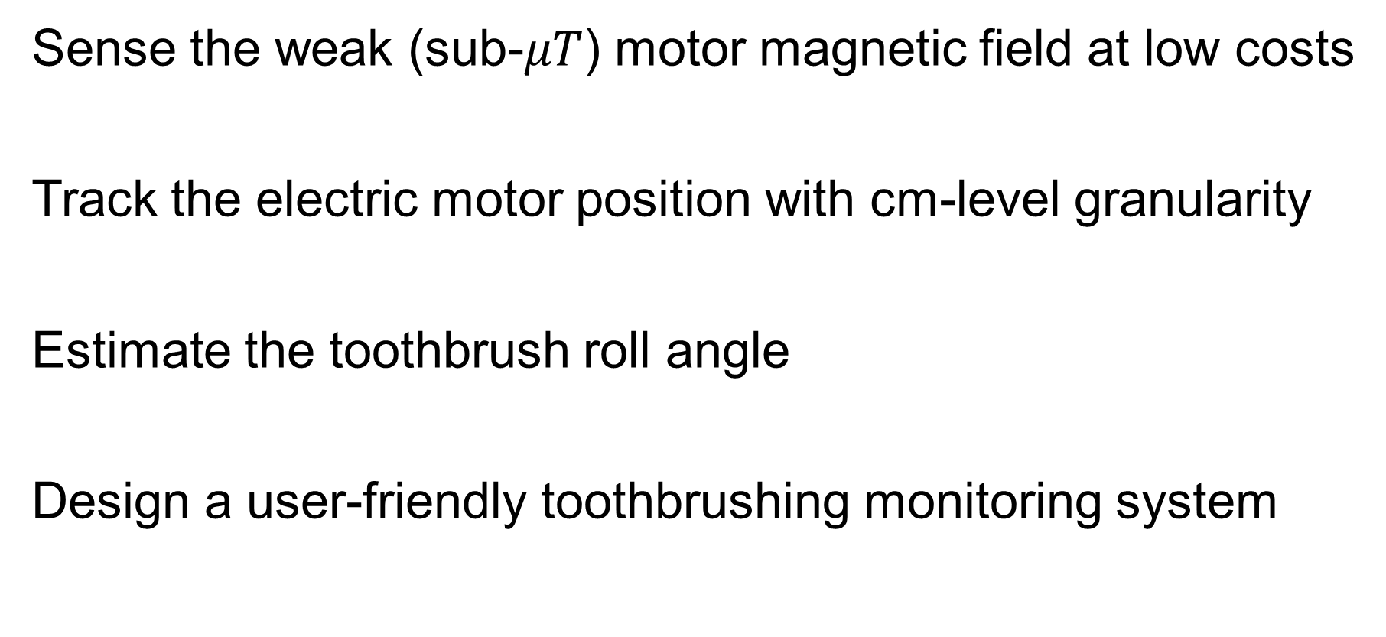
Challenges
Sense the weak (sub-$μT$) motor magnetic field at low costs
Track the electric motor position with cm-level granularity
Estimate the toothbrush roll angle
Design a user-friendly toothbrushing monitoring system
Notes:
There are many challenges in achieving this goal. The first challenge is to sense the motor magnetic field, which has a weak signal strength.
The second challenge is to achieve position tracking. Currently There is little understanding on the motor magnetic field distribution in the 3d space. Past research mainly focused on modeling the internal magnetic field of the motor.
We also need to address the challenge of recognizing the motor roll angle, which is crucial for brushing surface recognition. The motor roll angle has little influence on the magnetic field strength.
Finally, we need to design a convenient toothbrushing monitoring system so that the users do not need to provide extensive training data.

Slide 7
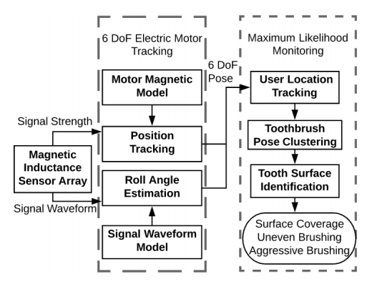
MET Overview
Notes:
Here is an overview of our solution.
To capture the electric motor magnetic field, we design a sensor array with eight inductive sensors. These sensors have high sensing fidelity and the sensor array has a low cost.
To achieve position tracking, we construct an approximate model by analyzing the magnetic field strengths. This model enables centi-meter level position tracking for the motor.
By analyzing the magnetic signal waveform, we design a machine learning algorithm that can track the roll angle of the motor.
Based on position and orientation tracking of the toothbrush, we design a clustering based algorithm to recognize the toothbrushing surface of the user. This system does not require any training data from the users.

Slide 8
Contributions
MET: an Magnetic inductive sensing based Electric Toothbrushing monitoring system
The first work to perform motor position and orientation tracking based on the sensing and modeling of the magnetic field
Fine-grained monitoring algorithms that monitors the brushing coverage of all the 15 tooth surfaces
Achieved an accuracy of 85.3% in an evaluation with 14 users
Notes:
Here are our contributions. We designed MET: a Magnetic inductive sensing based Electric Toothbrushing monitoring system
We developed the first system that use the existing magnetic field as a signal to track an electric motor’s position and orientation
Based on the tracking results, we designed fine-grained monitoring algorithms that monitors the brushing coverage of all the 15 tooth surfaces
In an experiment with 14 users, our system achieved a brushing surface recognition accuracy of 85.3%. Our system significantly outperform existing commercial systems.

Slide 9
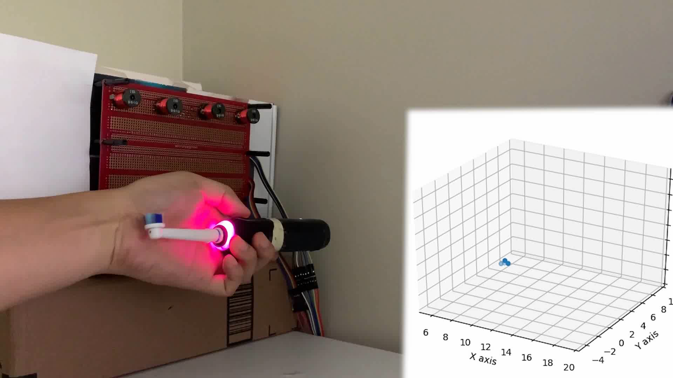
System Demo
Notes:
Here is a demo of our system. Based on sensing the magnetic field, MET is able to track the position of the electric toothbrush. Our system can also estimate the yaw and pitch angles of the toothbrush.

Slide 10
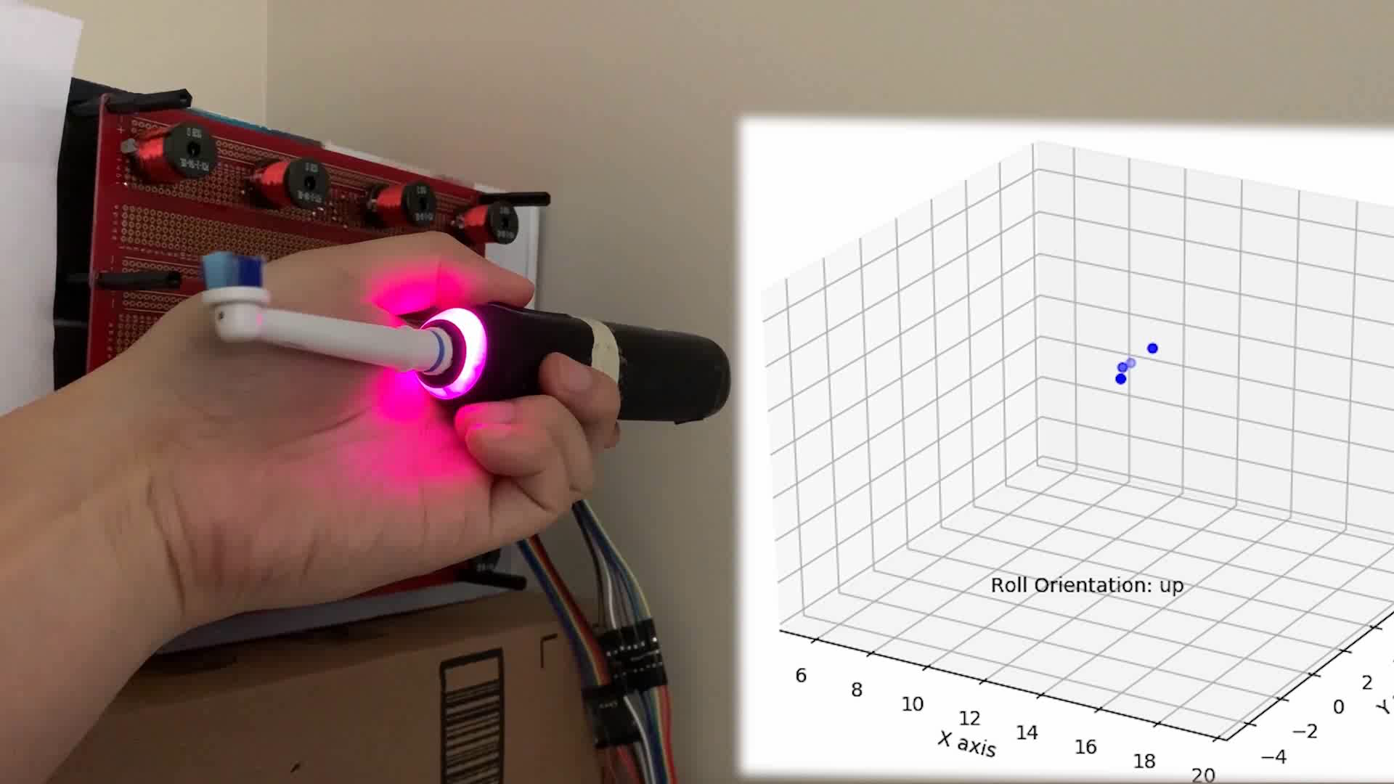
System Demo
Notes:
By analyzing the motor magnetic field, our system can also track the roll angle of the toothbrush

Slide 11
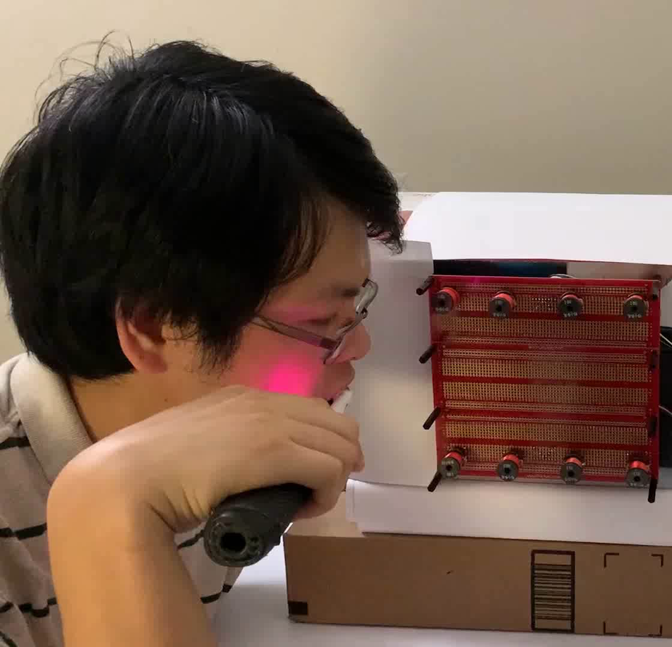
System Demo
Notes:
Based on position and roll angle tracking results, our system will recognize the toothbrushing surface and techniques, and provide the brushing quality report after the user finishes.

Slide 12
Sensor Design
Notes:
I will firstly introduce the design of our sensor array.

Slide 13
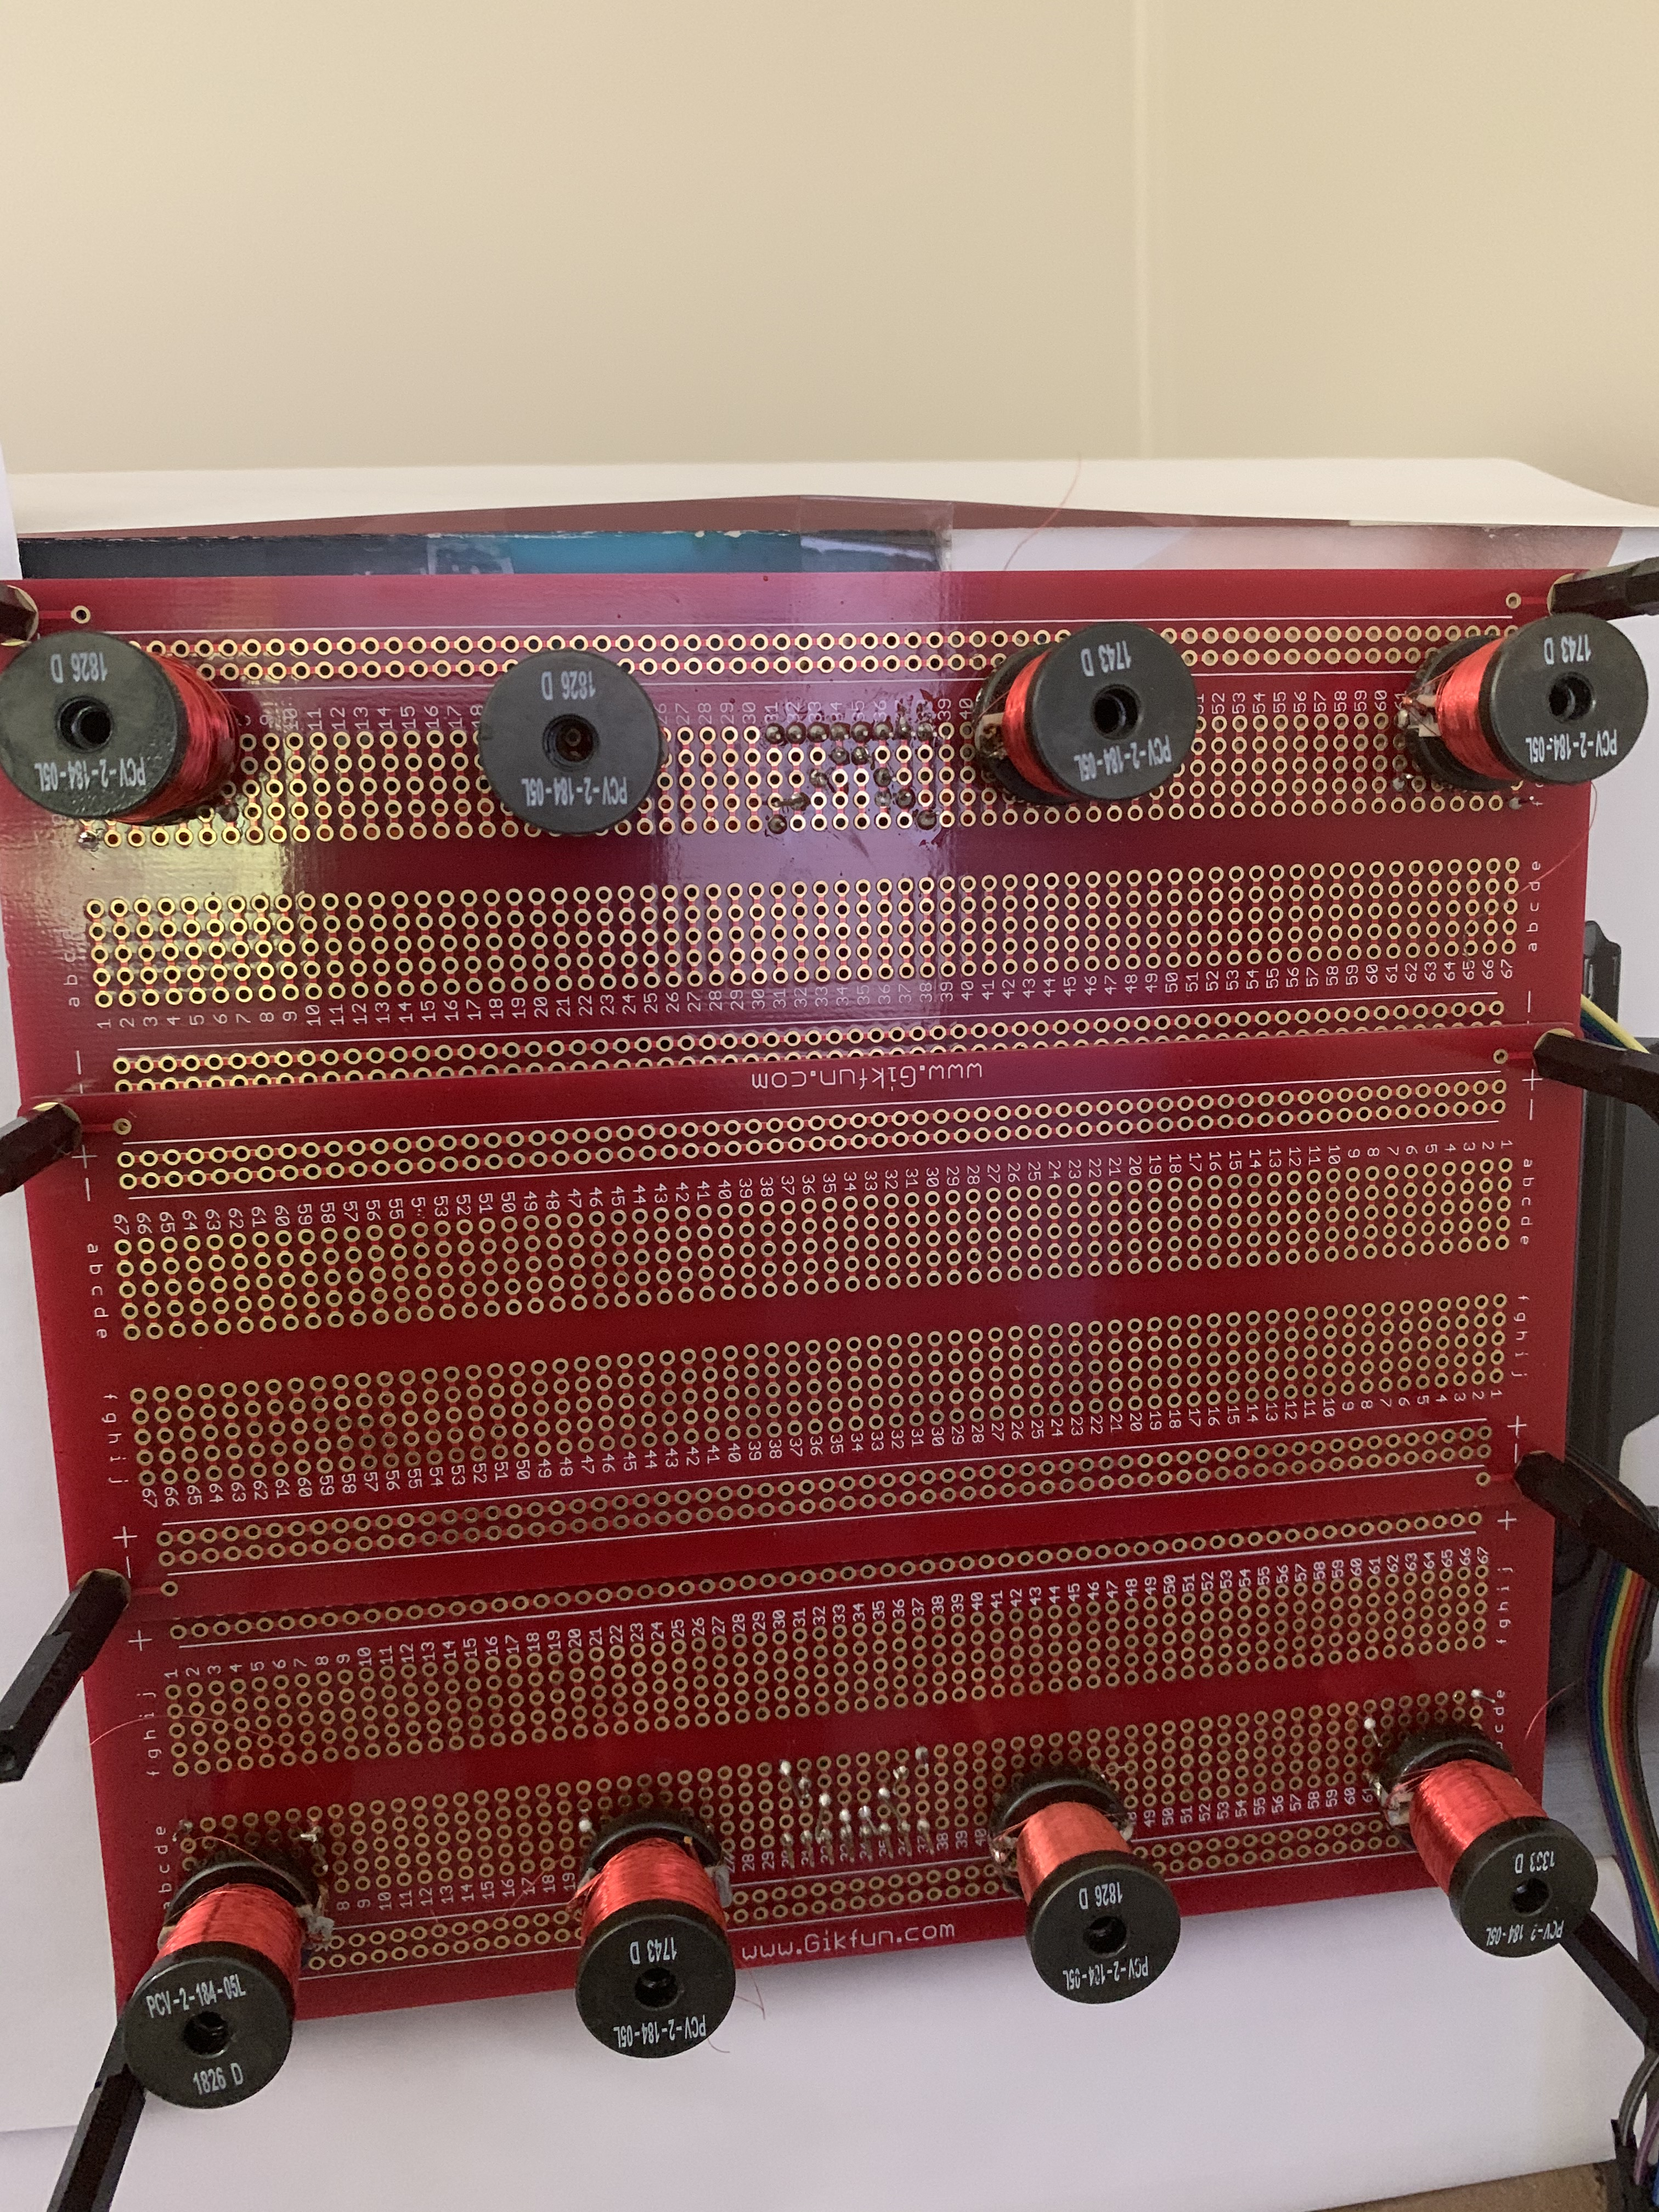
Sensor Design
Magneto-Inductive Coil Design
4000 rounds
Ferrite core
Sensor Array
Signal Processing
Spectral subtraction
Band-pass filtering
Notes:
We select the inductive sensor over other magnetic sensors due to its high sensing fidelity, robustness and low costs. To build the sensors, we have considered several factors, including the sensor sensitivity and the sensor form-factor. In our final design, each sensor coil has four thousand rounds of wire, and contains a ferrite core, which improves the signal strength.
We organized eight inductive coils into an array. Each sensor has its unique spatial position so that it can provide independent magnetic field measurements to improve tracking accuracy.
We have leveraged several signal processing techniques, including the spectral subtraction and the band-path filtering.

Slide 14
Motor Position Tracking
Notes:
Next I will introduce how to achieve position tracking for an electric motor

Slide 15
Motor Magnetic Field Monitoring Research
Existing Research
Magnetic noise modeling [1]
Health diagnosis [2]
Finite Element Method (FEM) for motor [3]
Missing Gap: motor magnetic field distribution in the outside space; essential for motor position tracking
[1] Ueda et.al. "Magnetic noise reduction technique for an AC motor driven by a PWM inverter." IEEE transactions on power electronics 1991.
[2] Dong et.al. Fault diagnosis and signal reconstruction of Hall sensors in brushless permanent magnet motor drives. IEEE Transactions on Energy Conversion, 2015.
[3] Arumugam et.al. "Magnetic field analysis of a switched reluctance motor using a two dimensional finite element model." IEEE Transactions on Magnetics 1985.
Notes:
There has been extensive research on applying magnetic sensing for a motor. For example, there are works on motor magnetic noises analysis and motor health diagnosis based on magnetic sensing. However, little work was dedicated to analyze the spatial distribution of the motor magnetic field for position tracking.
To analyze motor magnetic field, an established approach is the finite element method. However, we cannot apply this approach since it requires detailed parameters of the motor, which are unavailable to us.

Slide 16
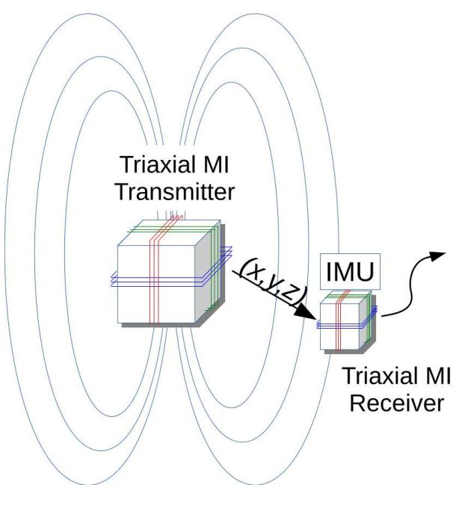
Cooperative Magnetic Position Tracking
Approach: attach magnetic tags on the target, sense the emitted magnetic field for position tracking
Pros
Accurate
Cons
Magnetic tags required
Position tracking with
magnetic tags
[1] Abrudan, et.al "Distortion rejecting magneto-inductive three-dimensional localization (MagLoc)." IEEE Journal on Selected Areas in Communications, 2015
[2] Huang, et. al. "MagTrack: Enabling Safe Driving Monitoring with Wearable Magnetics." MobiSys. 2019.
Notes:
Magnetic sensing has been used for position tracking before.
In particular, there are cooperative magnetic position tracking systems that attach magnetic tags on the target to generate magnetic signals for position tracking.
These system can achieve high tracking accuracy. However, we cannot use this approach because the additional magnetic tag will interfere with the normal operation of an electric toothbrush.

Slide 17
Non-Coorperative Magnetic Tracking
Approach: recognize the location based on magnetic field signatures
Pros
Use existing magnetic field
Cons
Low tracking granularity
Signature learning
[1] Shu et.al,"Magicol: Indoor localization using pervasive magnetic field and opportunistic WiFi sensing." IEEE Journal on Selected Areas in Communications 2015.
[2] Lu. et.al. "Simultaneous localization and mapping with power network electromagnetic field." In Mobicom. 2018.
Notes:
There are also non-cooperateive tracking systems that achieve coarse-grained localization using the targets’ existing magnetic field. For example, it is possible to achieve indoor localization based on modeling the magnetic field signature.
However, these signature based modeling techniques cannot achieve sufficient tracking accuracy for electric toothbrushing monitoring.
In this work, our goal is to achieve fine-grained tracking without any additional magnetic tags.
The unique approach we use is to construct an approximate analytical model for the motor magnetic field.

Slide 18
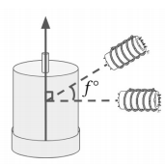


Motor Magnetic Field Modeling
Goal: obtain an approximate model for the spatial distribution of the motor magnetic field
Experiments: measure the field at different locations
$$c_{2}$$
$$c_{1}$$
Notes:
To track the motor positions, our first step is to understand the motor magnetic field distribution. To do so, as illustrated in this figure, we conduct experiments that measures the motor magnetic field with sensors at different locations.

Slide 19
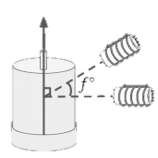
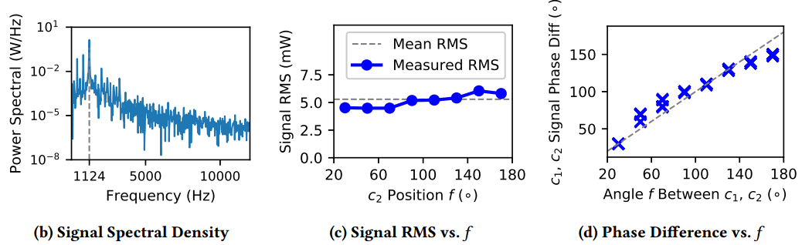
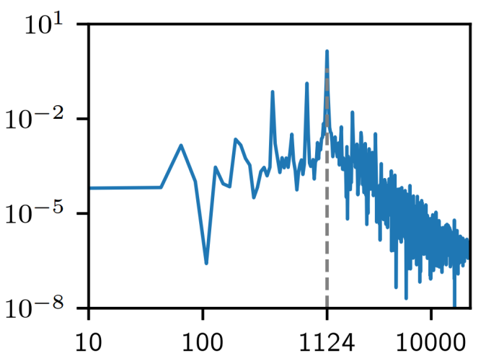



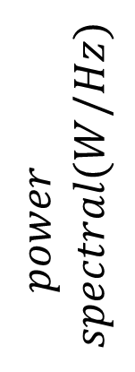





Motor Magnetic Field Modeling: Observations
Roll angle
Signals are periodic
Signal strengths stable against roll angle
Signal phase approximately equals to roll angle
$$Power Spectral$$
$$Signal Strength$$
$$Signal Phase$$
$$power$$
$$spectral(W/Hz)$$
$$strength(mW)$$
$$phase(°)$$
$$frequency (Hz)$$
$roll angle$ $(°)$
$roll angle$ $(°)$
Notes:
Here are our observations.
First, the magnetic signals are highly periodic. This is illustrated in the power spectral of the magnetic signal, which has a large peak at a single frequency.
Second, the motor magnetic field strengths is not influenced by the motor roll angle
And finally, the magnetic signal phase is equal to the motor roll angle.

Slide 20
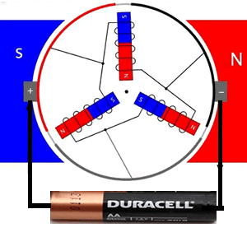





Motor Magnetic Moment Modeling: Approximation
Intuition: the motor resembles a rotating magnet in terms of magnetic field strengths
Approximate Motor Magnetic Moment:
$$≈$$
$$M_{0}(t)$$
$$=\left|M\right|$$
$${[0,\cos{ωt},\sin{ωt}] }^{T}$$
Notes:
Based on these observations, we construct an approximate magnetic model.
The intuition is that if we replace the electric motor with a rotating magnet, we can still get the same three observations.
Based on this intuition, the magnetic moment of a motor is approximated using this equation, which describes the magnetic moment of a rotating magnet.

Slide 21
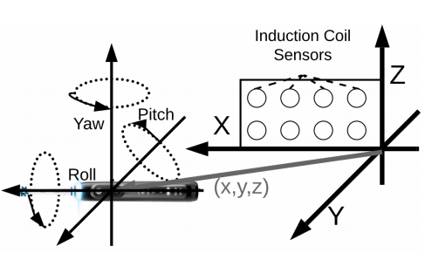



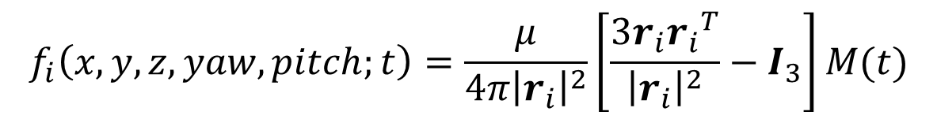
Motor Magnetic Model
Influence of rotation
Magnetic field distribution
Final Model:
$|f\left(∙\right)|,$ which maps position and orientation
to sensor measurement
$$M\left(t\right)=R_{z}\left(yaw\right){ R}_{y}\left(pitch\right) M_{0}(t)$$
$r_{i}:$ relative position
$$f_{i}\left(x,y,z,yaw, pitch;t\right)=\frac{μ}{4π{\left|r_{i}\right|}^{2}}\left[\frac{3r_{i}{r_{i}}^{T}}{{\left|r_{i}\right|}^{2}}−I_{3}\right]M(t)$$
Notes:
Next, we analyze the influence of the motor orientation change, which includes the change of the yaw and pitch angles. In particular, The influence of orientation change is computed using the rotation matrices.
Then we can calculate the field at the sensor using the standard magnetic field distribution equation.
In this equation, r represents the relative position between a sensor and the motor. Mt represents the approximated magnetic moment of the motor.
The final model, represented by the root mean square of f, is an analytical function that maps the position and orientation to the magnetic field strength.

Slide 22
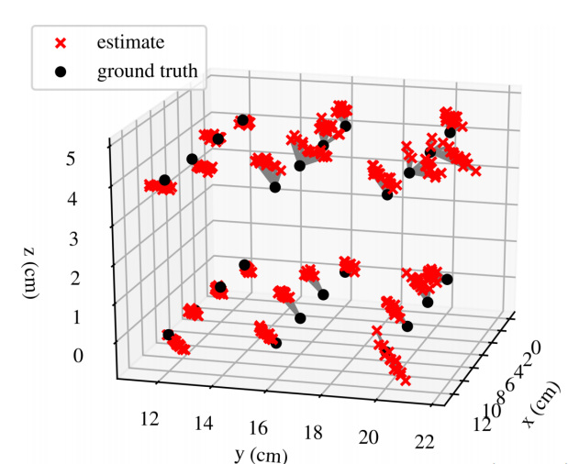
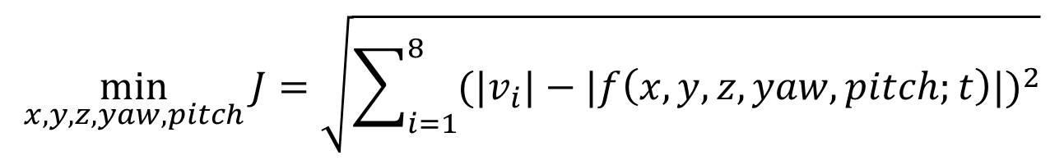

Position Tracking
  ${|v}_{i}|$: measured magnetic field Root Mean Squared (RMS)
  $|f_{i}\left(∙\right)|$: predicted magnetic field RMS
$$\min_{x,y,z,yaw,pitch}{J=\sqrt{\sum_{i=1}^{8}{{({|v}_{i}|−|f\left(x,y,z,yaw,pitch;t\right)|)}^{2}}}}$$
Notes:
Based on this model, We can formulate an optimization algorithm to estimate the toothbrush position.
In this equation, v represents the actual sensor measurement, and f represents the predicted magnetic field.
Our algorithm searches the values of the motor position and orientation such that the model predictions are closest to the sensor measurements.
This figure shows some sample tracking results. We can see that the estimated positions, which are represented by the red crosses, are close to the ground truth positions.

Slide 23
Motor Roll Angle Estimation
Notes:
Next I’m going to present how we achieve roll angle estimation

Slide 24
Challenge: Roll Angle Estimation
Roll angle does not influence magnetic field strength
Solution: use time-domain signal signature for roll angle estimation
Notes:
As we have seen in one of the previous experiment, the toothbrush roll angle change does not influence the magnetic field strength. Instead, we rely on the time domain magnetic signal signature for roll angle tracking.

Slide 25
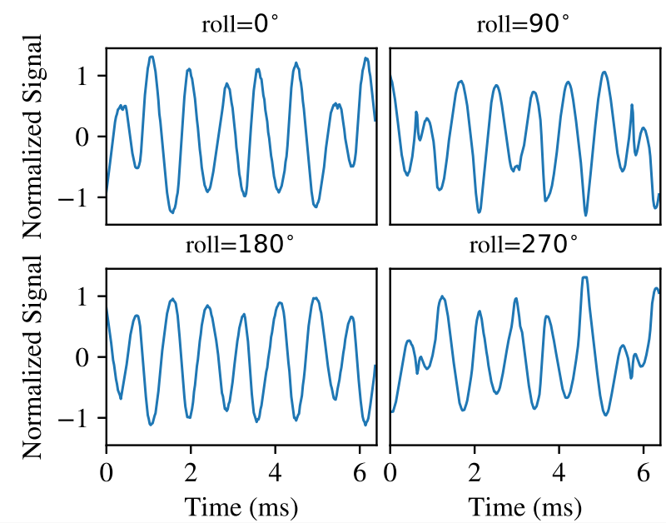
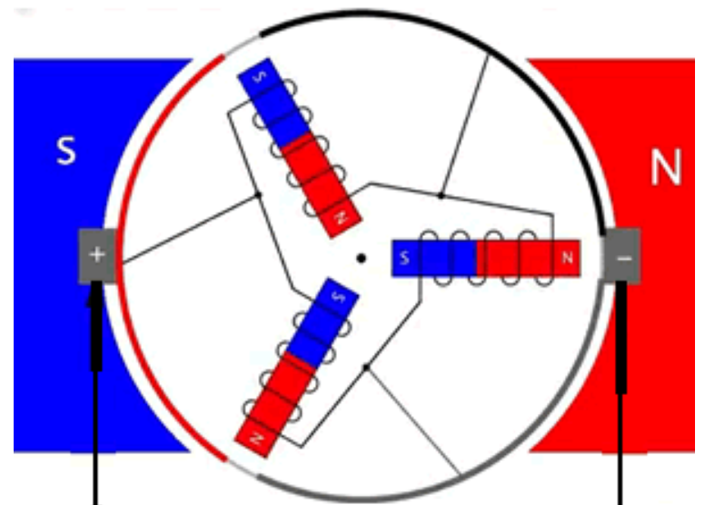
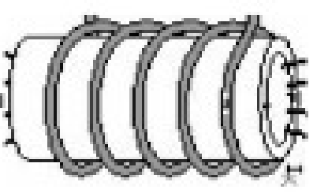




Experiment: Signal Waveform vs. Roll Angle
$$B$$
$$B$$
$$B$$
$$B$$
time
time
Notes:
Here is our experiment. we record magnetic signals
when the toothbrush
had different roll angles.

Slide 26
Experiment: Signal Waveform vs. Roll Angle
$$B$$
$$B$$
$$B$$
$$B$$
time
time
Observation: Roll angles reflected by signal waveforms
Notes:
Our sensors record different waveforms when the toothbrush has different roll angles. For example, on the left, these two figures are inverse to each other.
On the right, the two figures have small jumps in the waveforms, and they are also inverse to each other.

Slide 27
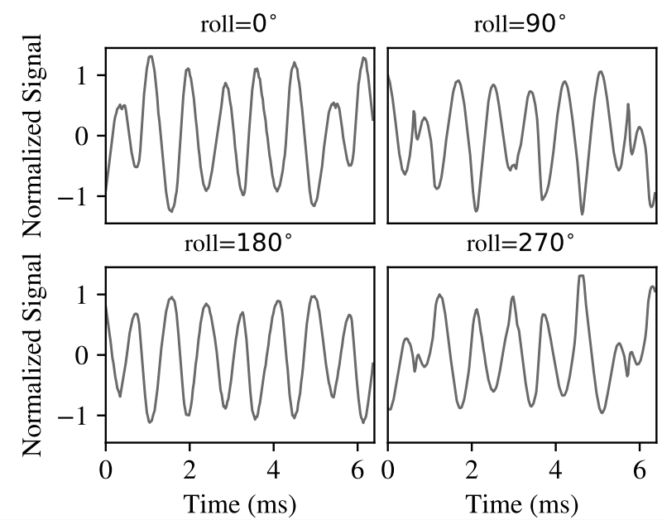
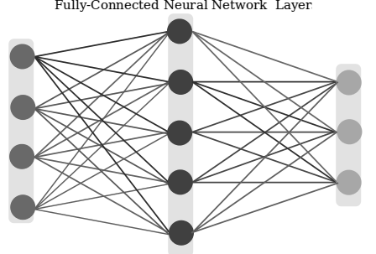
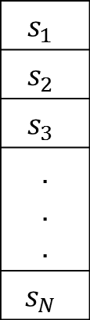
The Roll Angle Classification Algorithm
$$s_{1}$$
$$s_{2}$$
$$s_{3}$$
. . .
$$s_{N}$$
roll
angle
sensor
data
similarity
measures
template
signal
signal
signature
deep neural
network
Notes:
Based on this observation, we developed a machine learning based algorithm to recognize the toothbrush roll angle. The overview is as follows.
All the sensors are collecting the magnetic field signal concurrently.
Then we compute the similarity between these measured signals and a set of template signals. The template signals are collected with known roll angle of the toothbrush before hand.
These similarity values contain rich information about the toothbrush roll angle, and we treat them as a feature set.
we have tested several different classification algorithms and we selected the deep neural network due to its good performance. The algorithm returns a coarse grained prediction of the toothbrush roll angle. That is, up, right, down, and left. This is how we achieve toothbrush roll angle estimation.

Slide 28
Toothbrushing Monitoring
Notes:
Based on the toothrbrush position and orientation tracking results, we are now ready to design the toothbrushing surface recognition algorithm

Slide 29
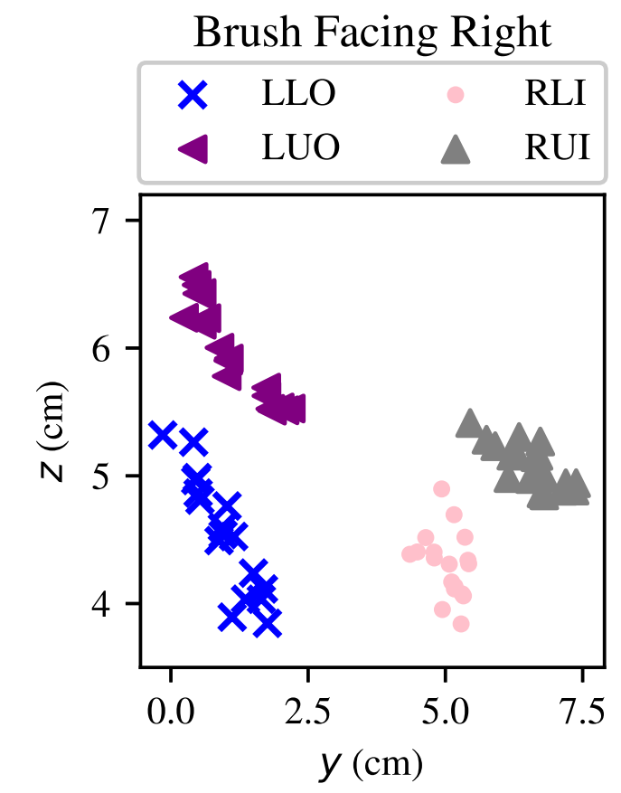
Toothbrush Position Clustering
Classify brushing surfaces according to the roll angle
Gaussian Mixture Model algorithm for clustering
Surface labeling according to the relative positions
HMM for movement tracking
Left Upper Outer (LUO)
Right Upper Inner (RUI)
vertical
coordinate
Left Lower Outer (LLO)
Right Lower Inner (RLI)
horizontal coordinate
Notes:
The first step is to classify the toothbrush positions based on the roll angle estimation results.
In this figure, we plot the toothbrush positions when the toothbrush roll angle is facing right. We can see that when brushing different surfaces, the toothbrush positions form distinguishable clusters. We conduct a normality test on the data and the result shows that each cluster follows a gaussian distribution. This motivates us to use the gaussian mixture model algorithm to conduct clustering on the toothbrush positions.
After we finish clustering, we can then label these clusters automatically based on their relative positions.
In this example, we can find the labels for the left upper,
left lower,
right lower and
right upper surfaces. This is how we recognize the brushing surface when the user is standing still
In the case of movement during brushing, we used a hidden markov model to track the user’s mvoements

Slide 30
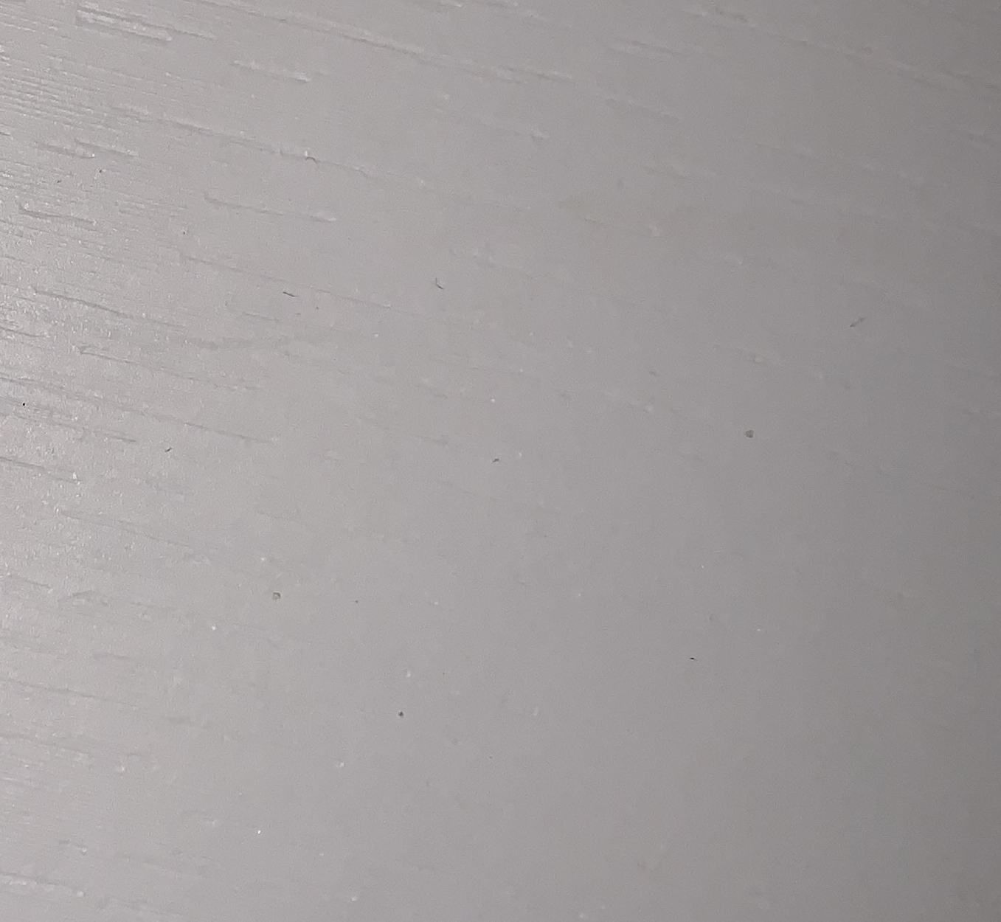
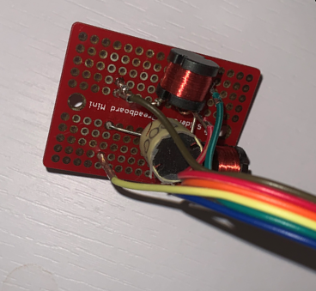
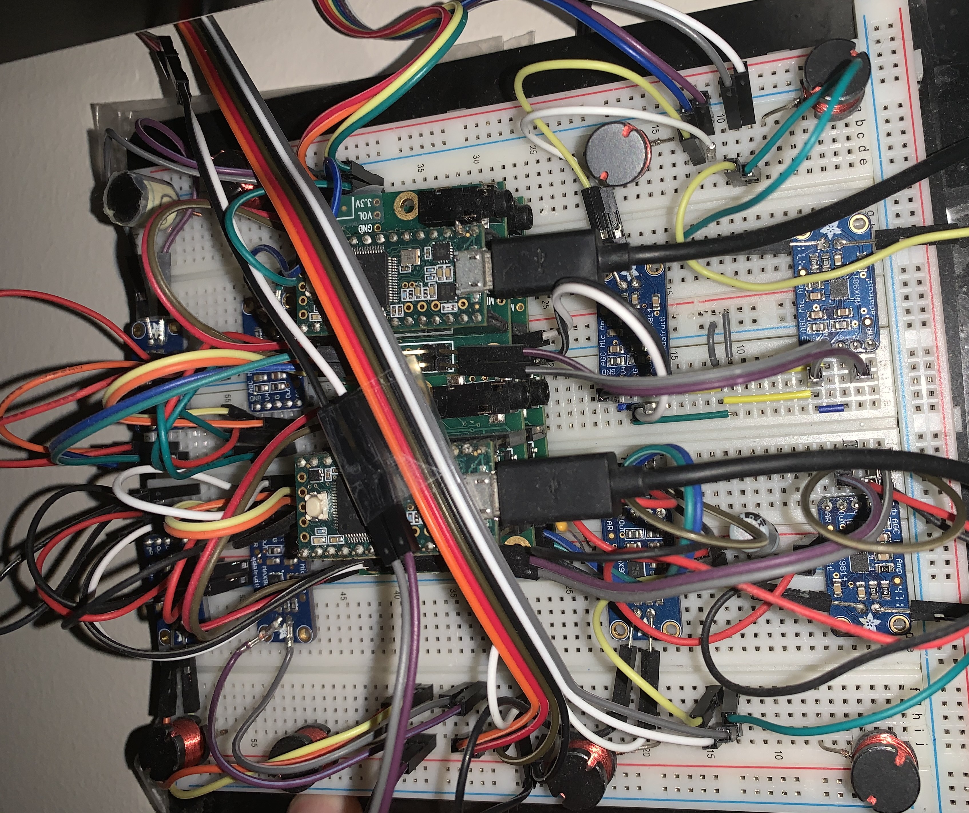
Implementation
Tested Sensor Coil Designs
Individual coils
3D orthogonal coils
8-coil sensor array
Soldered 8-coil sensor array
Flexible Coils
Orthogonal Coils
Sensor Array
Soldered Sensor Array
Notes:
We have tested several generations of sensor coil designs. In the earlier versions, we tested the performance of the commercial off the shelf search coil sensors
Later, we improved the sensor sensitivity by increasing the number of rounds, and we tested a different sensor design which deployed inductive coils in orthogonal directions
In our experiments, we found that the tracking accuracy was higher when the coils had greater diversity in their spatial positions. So we later deployed the coils in a 2d plane. We implemented this design on a bread board.
After verifying the effectiveness, we finally soldered the inductive coils to achieve better robustness.

Slide 31
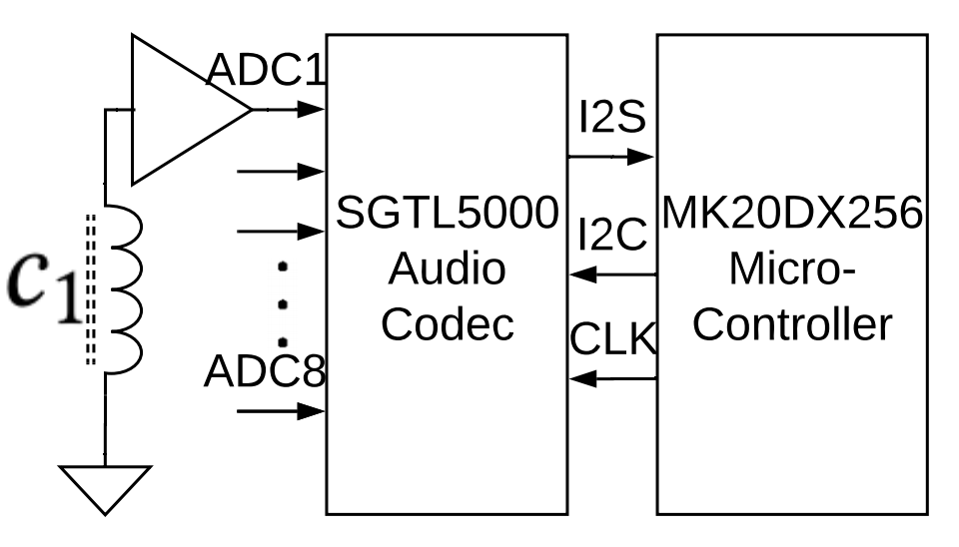
Implementation
The peripheral circuit design
A Lost-Cost
High resolution (16 bit)
High rate (44000Hz)
Multi-Channel (8-Ch)
Notes:
Here is the circuit diagram of our system. We have selected the audio codec to digitize the magnetic signals. In doing so, we achieved a system that is low cost, has high digitization resolution, high sampling rate, and can digitize eight channels simultaneously

Slide 32
Evaluation
Notes:
Next I will present the evaluation results.

Slide 33
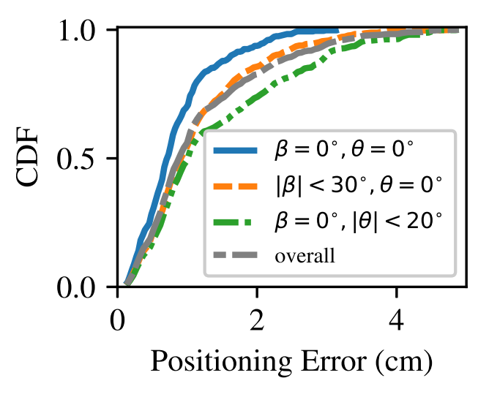

Position Tracking
  Setup:
  32 positions in $12∗12∗4 {cm}^{3}$ space
  Result:
  Mean error: 2.2 cm
  90 percentile: 4.1 cm
Notes:
In the first experiment, we placed the toothbrush at 32 3d positions. The mean tracking error is 2.2 centimeters, and the ninety percentile tracking error is 4.1 centimeters

Slide 34
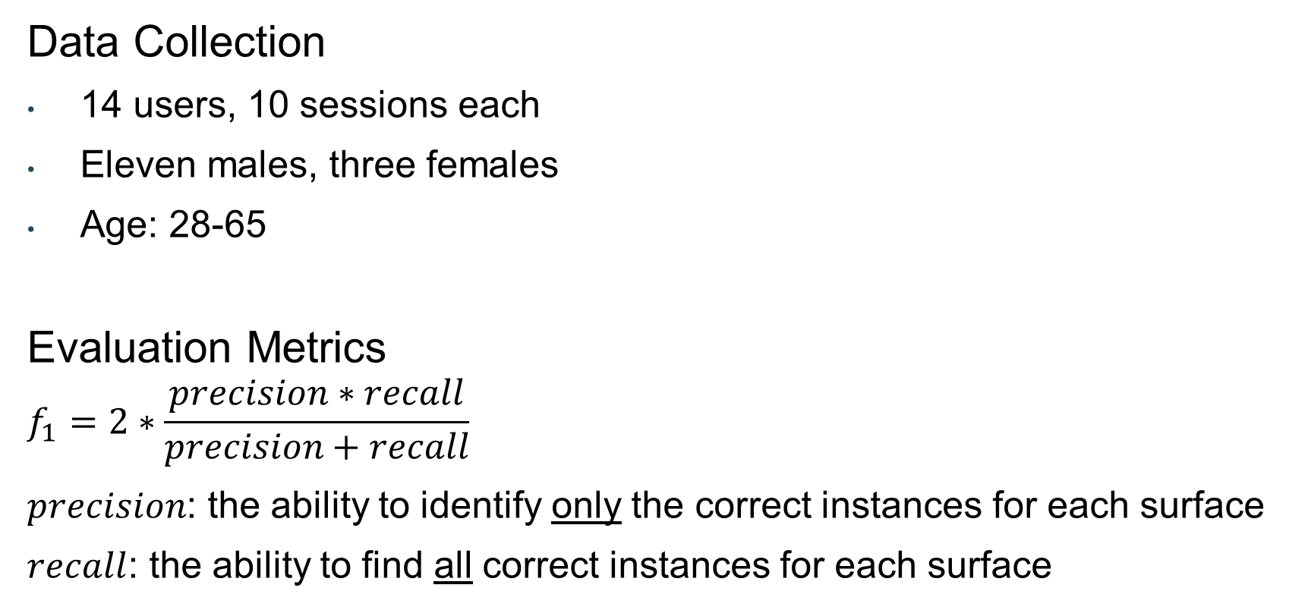
Toothbrushing Monitoring Experiment
Data Collection
14 users, 10 sessions each
Eleven males, three females
Age: 28-65
Evaluation Metrics
$$f_{1}=2∗\frac{precision∗recall}{precision+recall}$$
$precision$: the ability to identify only the correct instances for each surface
$recall$: the ability to find all correct instances for each surface
Notes:
To evaluate the toothbrushing monitoring accuracy, We recruited 14 volunteers, and each brushed for 10 times.
We select the f 1 score as a metric to evaluate recognition accuracy.

Slide 35
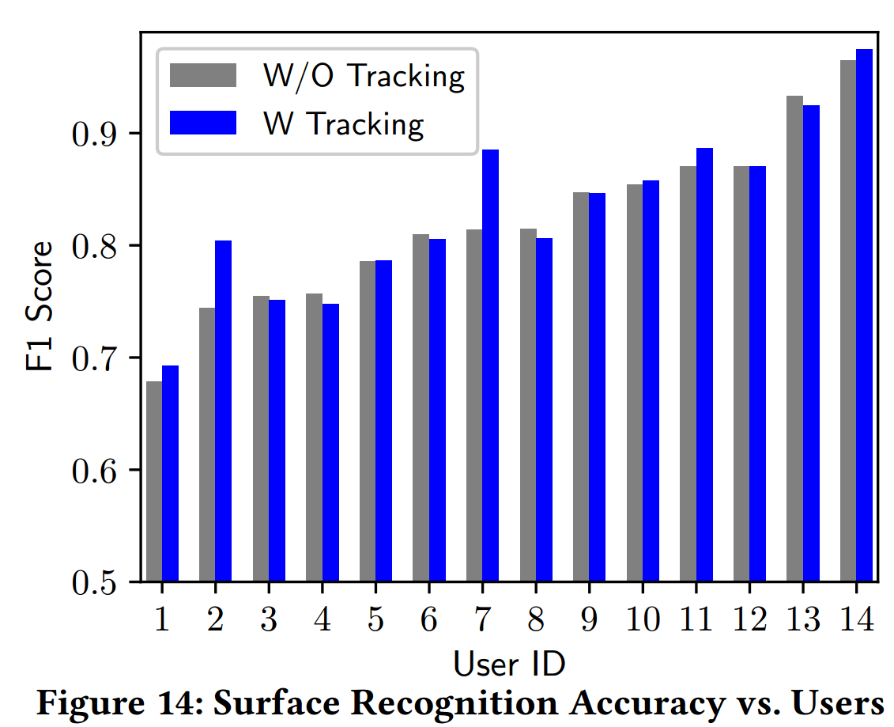

Brushing Surface Recognition
  Mean monitoring $f_{1}$: 85.3%.
  $f_{1}$ score range: 68% to 95%
Notes:
Here is the brushing surface recognition accuracy for all the fourteen users. The overall accuracy is 85.3 percent.
The recognition accuracy ranges from 68% to 95%. The key factors that influence the accuracy include habits in placing the toothbrushes and the user movements. In the future, we will use personalized brushing recognition models to improve the performance.

Slide 36
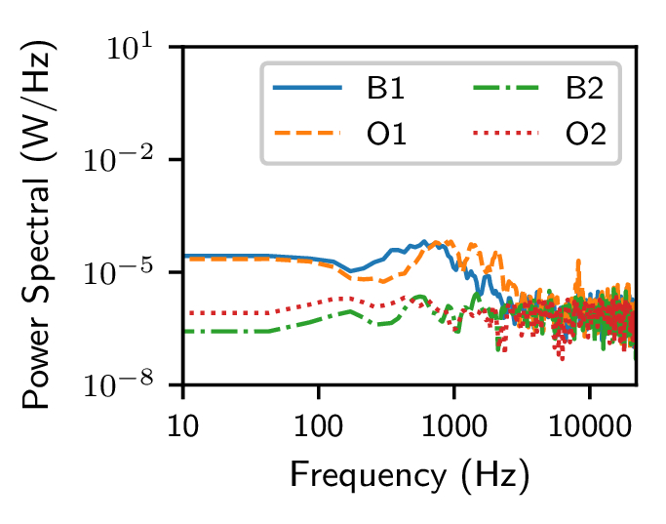
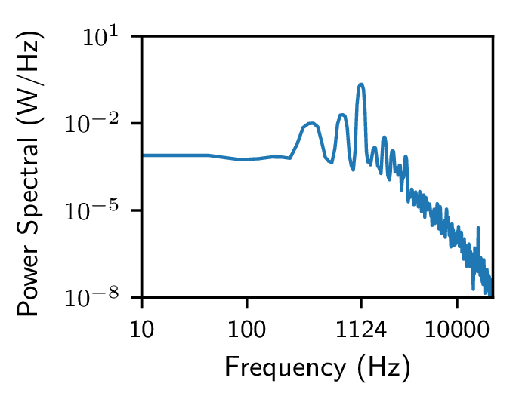
Environmental Noises
Experiment: collect magnetic noise at 4 rooms
Result: 2 magnitudes weaker than signal
Noise Power Spectral
Signal Power Spectral
Notes:
We measured the background magnetic noises at four different rooms, and plot their spectral densities
When we compare the noise with the toothbrush motor magnetic signals, we can see that the signal is around two magnitudes stronger at the desired frequency of one thousand herts.
We have also tested the influence of common metal objects, such as metal furnitures, plates, and dental implants. We have not observed significant effects on the monitoring accuracy.

Slide 37
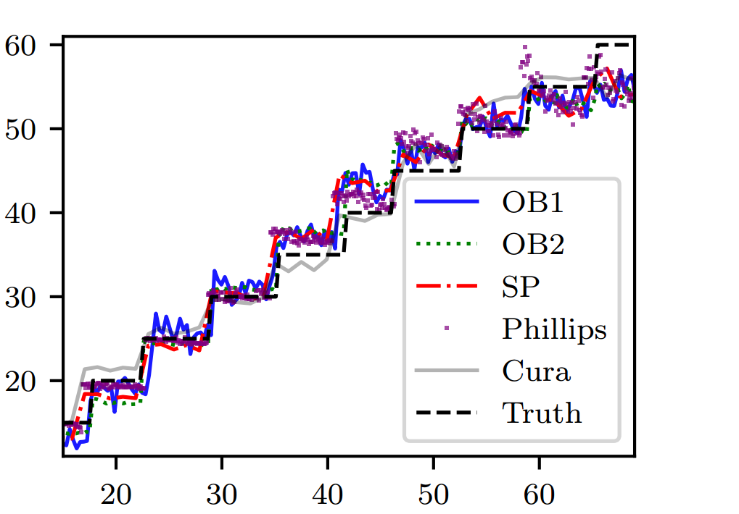
Tracking of Other Electric Motors
Method: A preliminary linear regression model for 1d tracking
Results: Within a range of 60cm, error<5cm. 4 different electric toothbrushes
Distance (cm)
Time (s)
Notes:
We also conducted an experiment on tracking 4 other electric toothbrushes that use different types electric motor, including brushed motors and linear actuator units. We constructed a preliminary linear regression model that maps magnetic signal strengths to the distance. As illustrated in this figure, the tracking error is less than 5 centimeters when the distance is less than 60 centimeters. In the future, we will further extend our model to enable multi-dimensional tracking for different motor types.

Slide 38
Conclusion
MET - an electrical toothbrushing monitoring system based on magnetic sensing that monitors fine-grained brushing activities
A new method that achieves the position and orientation tracking of an electric motor based on magnetic sensing
Evaluation with 14 users. Achieved a monitoring accuracy of 85.3%, significantly outperforming commercial systems
Notes:
In conclusion, In this work, we introduce MET - an electric toothbrushing monitoring system that is based on magnetic sensing. Our system achieves fine-grained monitoring of toothbrushing coverage and brushing techniques.
We develop a new method that tracks the position and orientation of an electric motor based on its magnetic field's sensing and modeling.
In experiments with 14 users, we achieve a toothbrushing monitoring accuracy of 85.3 percent. MET significantly outperforms leading commercial systems.

Slide 39
Thank You !
Hua Huang
hhuang80@ucmerced.edu
Shan Lin
shan.x.lin@stonybrook.edu
Notes:
Thank you for listening. I am glad to answer questions.

