Slide 1
An STL-based Formulation of Resilience in Cyber-Physical Systems
Hongkai Chen¹, Shan Lin¹, Scott A. Smolka¹, and Nicola Paoletti²
¹ Stony Brook University, Stony Brook, USA
² Royal Holloway, University of London, UK
Presented at the 20th International Conference on Formal Modeling and Analysis of Timed Systems (FORMATS 2022)
Notes:
Hello everyone, my name is Hongkai Chen and today I am glad to present our work “An STL-based formulation of resilience in cyber physical systems”.

Slide 2

What is Resilience?
resiliency
noun
an ability to recover from or adjust easily to adversity or change
Notes:
What is resilience?
In a dictionary, it is commonly seen as an ability to recover from or adjust easily to adversity or change.

Slide 3
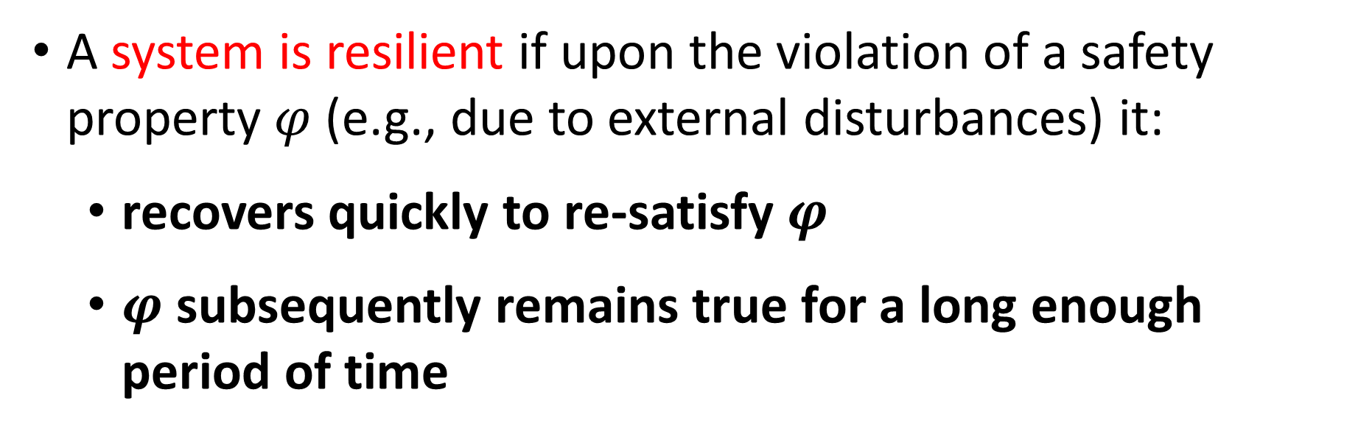
What is Resilience?
A system is resilient if upon the violation of a safety property $φ$ (e.g., due to external disturbances) it:
  recovers quickly to re-satisfy $φ$
  $φ$ subsequently remains true for a long enough period of time
Notes:
From a cyber physical system perspective, a system is resilient if upon violation of a safety property, for example, because of an external disturbance)
It recovers quickly to re-satisfy the safety property, which subsequently remains true for a long enough period of time.

Slide 4
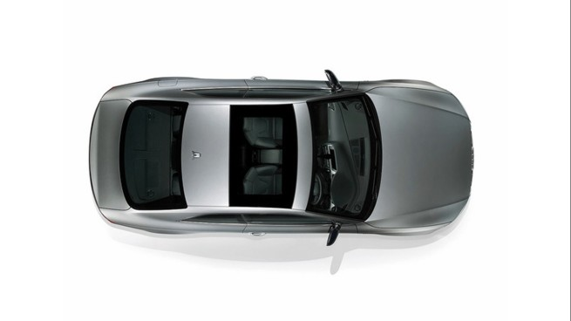

What is Resilience: Lane Keeping
Notes:
Take lane keeping as an example.
Satisfying the lane-keeping requirement globally is too restrictive when an obstacle forces the vehicle to depart from the lane.
Instead, vehicle is resilient if it quickly returns to its lane and remains in the lane for as long as necessary.
%Other examples includes blood glucose control in which the glucose level should resiliently recovers after a hyperglycemia episode and remains in range.

Slide 5
Aim: Formalize CPS Resilience
Signal Temporal Logic (STL) [Donze10]
Can we formalize resiliency in STL?
How can we define an STL-like semantics to quantify resiliency?
Notes:
In our work, we aim to formalize resilience in cps.
Signal temporal logic (STL) is a natural choice for formalizing temporal specifications.
With STL, we aim to answer the following two questions.
First, can we …..
Second, How can we …

Slide 6
Related Work
Logic-based approaches
  STL time robustness [Donzé10] does not consider durability
  Time-shifting STL formulas [Aksaray21] only considers recoverability and no semantics provided
Control-theoretic characterization
  A resilience measure [Bouvier21] is the additional time needed for a system to reach a target under malfunctions
  A resilient system [Zhu11] can restore its state after extreme events belonging to specific perturbation classes
Notes:
There are two major lines of work that relates to CPS resilience.
The first is logic-based approaches to formalizing temporal properties.
However, they generally only considers the recoverability of a safety property, and some of them does not provide semantics.
The second line of work lies in control-theoretic characterization.
However, they usually define a resilience measure as a control objective and do not formulate the resilience from a logical perspective.

Slide 7
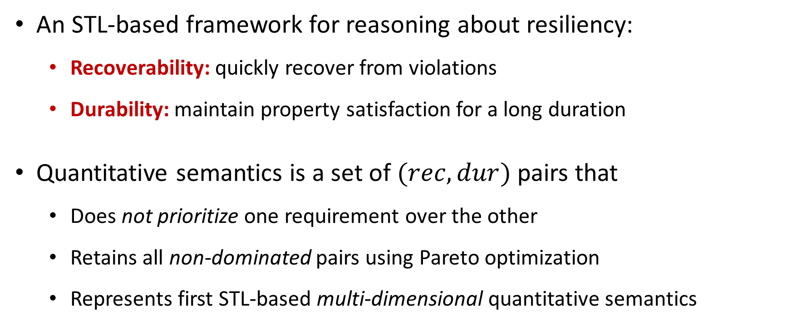
Our Contributions
An STL-based framework for reasoning about resiliency:
  Recoverability: quickly recover from violations
  Durability: maintain property satisfaction for a long duration
Quantitative semantics is a set of $(rec,dur)$ pairs that
  Does not prioritize one requirement over the other
  Retains all non-dominated pairs using Pareto optimization
  Represents first STL-based multi-dimensional quantitative semantics
Notes:
We conclude our contributions as follows.
The first is an STL-based framework for reasoning about resiliency. We formalize it as a combination of recoverability and durability.
The second is to provide a quantitative semantics using a set-based approach. It does not prioritize recoverability over durability or vice versa, hence retains all non-dominated pairs.
To the best of our knowledge, it represents the first STL-based multi-dimensional quantitative semantics.

Slide 8
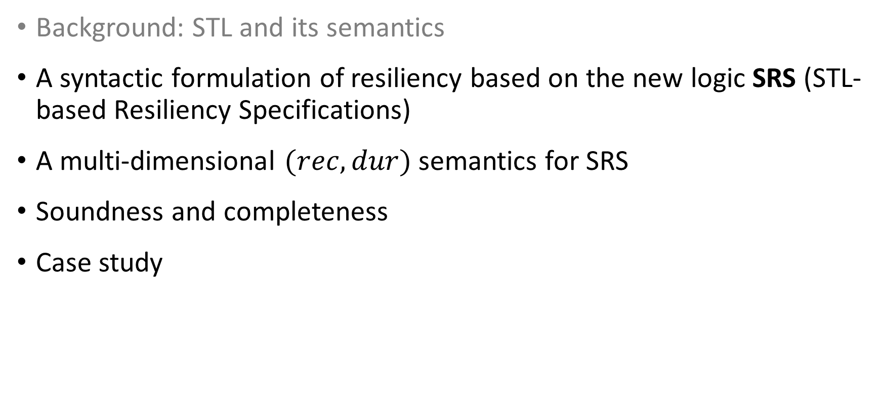
Presentation Outline
Background: STL and its semantics
A syntactic formulation of resiliency based on the new logic SRS (STL-based Resiliency Specifications)
A multi-dimensional $(rec,dur)$ semantics for SRS
Soundness and completeness
Case study
Notes:
In the remaining presentation, we first introduce the background of STL and its semantics

Slide 9
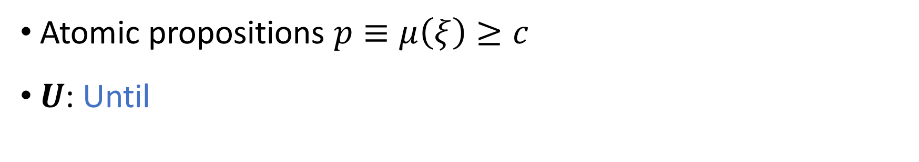

Signal Temporal Logic (STL) [Maler04, Donze10]
Atomic propositions $p≡μ\left(ξ\right)≥c$
$U$: Until
STL syntax
$φ ∷=p \left| ¬φ \right| φ_{1}∨φ_{2} \left| φ_{1}∧φ_{2} \right| φ_{1}U_{I}φ_{2}$
(Finally $φ$) $F_{I}φ=⊤U_{I}φ$
(Globally $φ$) $G_{I}φ=¬(F_{I}¬φ)$
Notes:
Signal temporal logic describes real-valued, temporal properties in cyber physical systems.
The atomic propositions is defined as an inequality in which a mapping \mu over a temporal signal ksai is no less than a real value c.
The temporal operator Until describes that phi_1 is true until phi_2 becomes true in time interval I.
The temporal operators Finally and Globally can be derived from Until.
The finally expression is true if phi is true at least once in I and the globally expression is true if phi is always true with in I

Slide 10
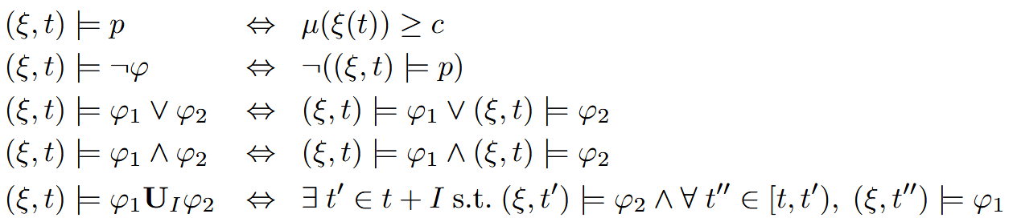

STL Boolean Semantics [Maler04, Donze10]
Discrete-time signals $ξ:𝕋→ℝ^{n}$
Boolean satisfaction: Qualitative measure of the Boolean satisfaction of $φ$
Notes:
In our work, we mainly consider discrete-time signals.
STL is equipped with a qualitative Boolean semantics indicating the satisfaction of a signal wrt a property at a given time.

Slide 11
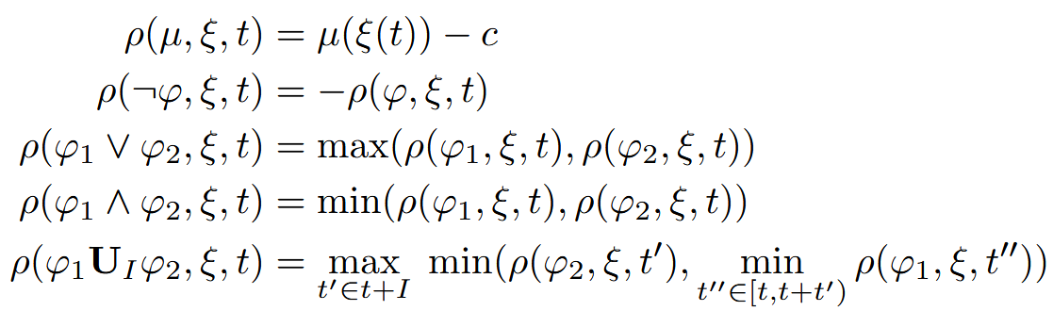

STL Space Robustness [Donze10]
Space robustness $ρ$: Quantitative measure of the Boolean satisfaction of $φ$
Notes:
The robustness semantics indicate the extend of the Boolean semantics.
It is a quantitative semantics that describes how much a signal can be perturbed (/pərˈtərbd/) before affecting the Boolean property satisfaction.
The robustness semantics are essentially using subtraction in place of comparison in the atomic case, and maximum and minimum in place of logical disjunction and conjunction in the composite cases.

Slide 12
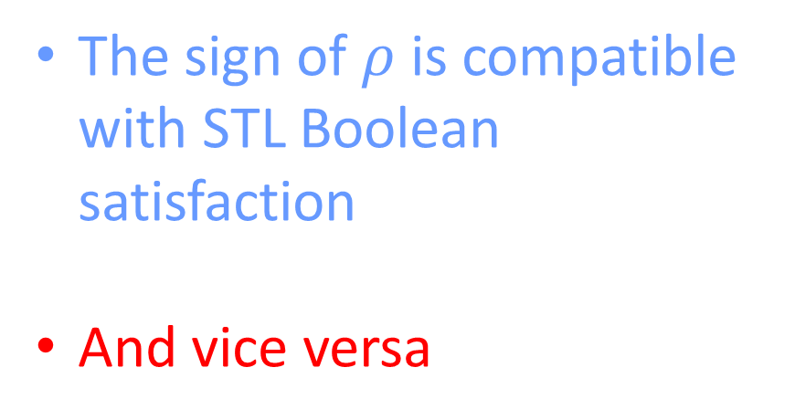

STL Space Robustness: Soundness and Completeness
The sign of $ρ$ is compatible with STL Boolean satisfaction
And vice versa
$ρ\left(φ,ξ,t\right)>0→\left(ξ,t\right)⊨φ$
$ρ\left(φ,ξ,t\right)<0→\left(ξ,t\right)⊭φ$
$\left(ξ,t\right)⊨φ→$ $ρ\left(φ,ξ,t\right)≥0$
$\left(ξ,t\right)⊭φ→$ $ρ\left(φ,ξ,t\right)≤0$
Notes:
The STL space robustness is sound and complete wrt to the Boolean semantics
In the sense that the sign of $ρ$ is compatible with STL Boolean satisfaction and vice versa

Slide 13
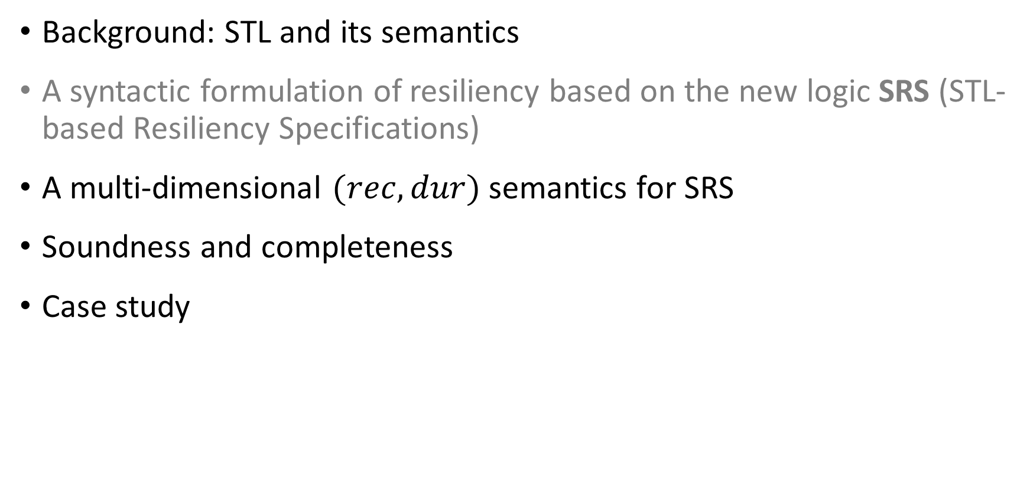
Presentation Outline
Background: STL and its semantics
A syntactic formulation of resiliency based on the new logic SRS (STL-based Resiliency Specifications)
A multi-dimensional $(rec,dur)$ semantics for SRS
Soundness and completeness
Case study
Notes:
Next, we introduce the syntax our new logic, srs

Slide 14
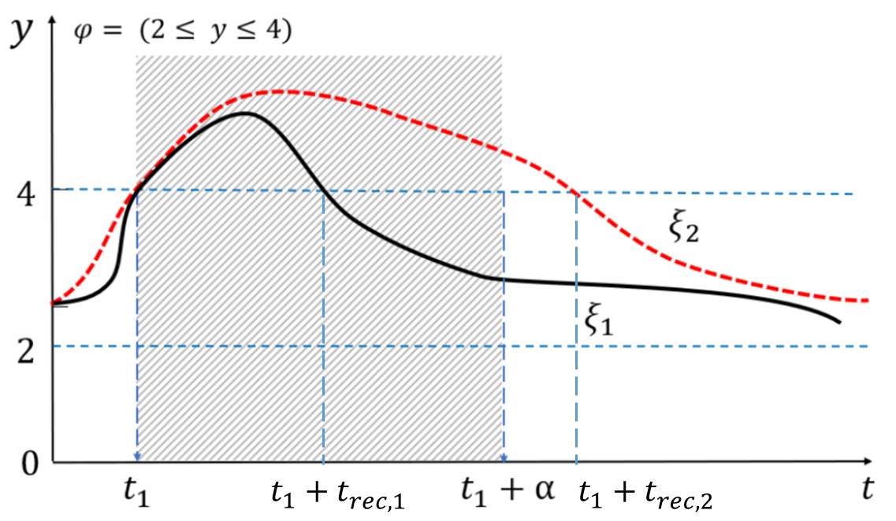
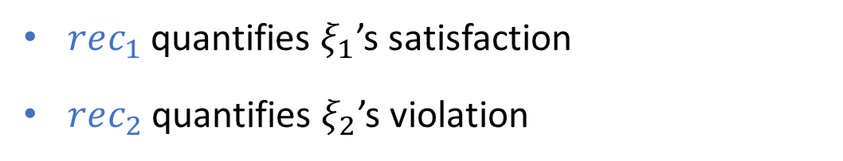
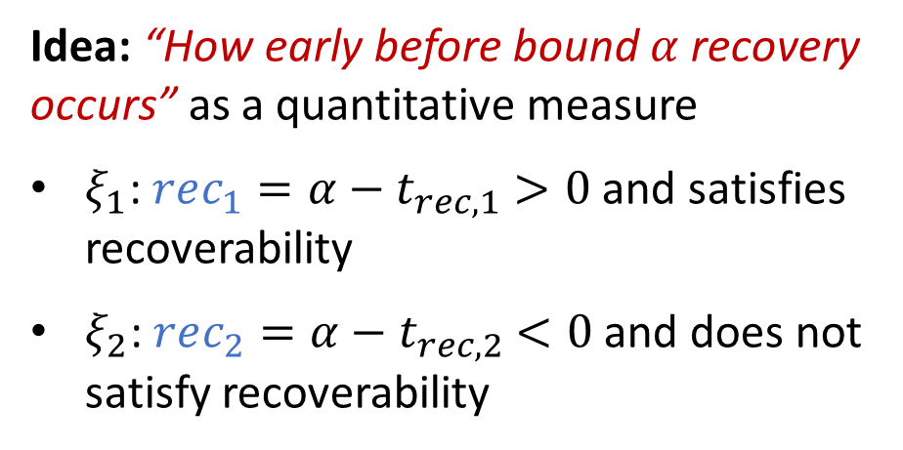
Recoverability in Resiliency
Recoverability: ability to recover from violation of $φ$ within time $α$
Idea: “How early before bound $α$ recovery occurs” as a quantitative measure
$ξ_{1}$: $rec_{1}=α−t_{rec,1}$ $>0$ and satisfies recoverability
$ξ_{2}$: $rec_{2}=α−t_{rec,2}$ $<0$ and does not satisfy recoverability
$rec_{1}$ quantifies $ξ_{1}$’s satisfaction
$rec_{2}$ quantifies $ξ_{2}$’s violation
Notes:
First, we investigate the recoverability in resiliency.
The recoverability is the ability to recover from a violation within time.
In this figure, phi requires the value of the signals to be between 2 and 4. Both signals violate phi at the same time. It is obvious that $ξ_{1}$ recovers within time alpha; whereas $ξ_{2}$ does not
We want to use a quantity to describe how early before bound alpha recovery occurs. We use the bound subtracted by the time to recover as a quantitative measure. For ksai_1, the quantity is greater than 0, measuring the satisfaction of recoverability. The opposite situation happens in ksai_2

Slide 15
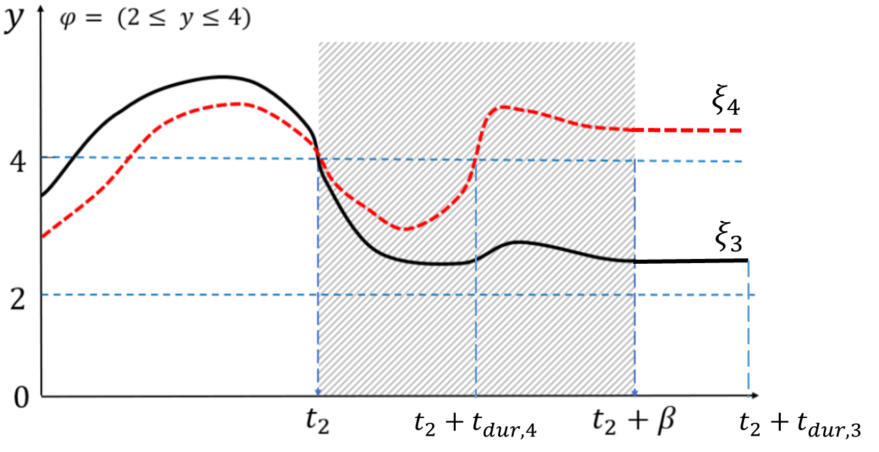
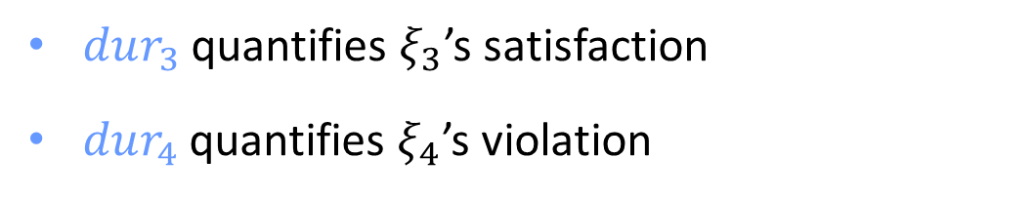
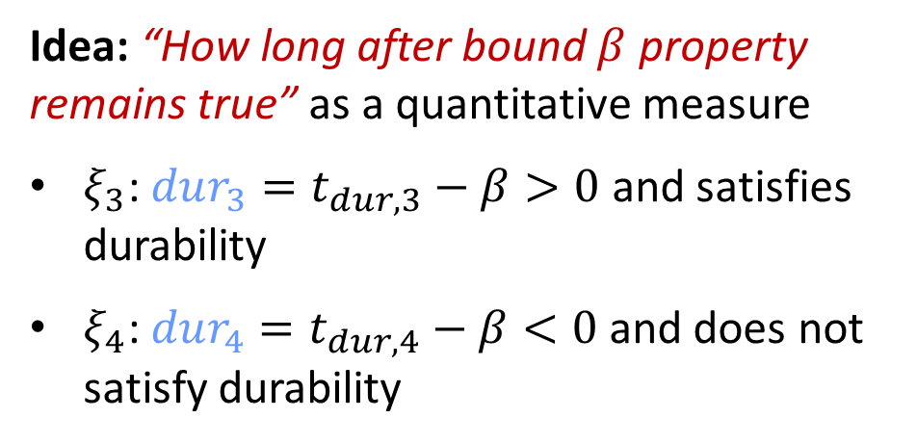
Durability in Resiliency
Durability: ability to maintain $φ$ for at least time $β$
Idea: “How long after bound $β$ property remains true” as a quantitative measure
$ξ_{3}$: $dur_{3}=t_{dur,3}−β>0$ and satisfies durability
$ξ_{4}$: $dur_{4}=t_{dur,4}−β<0$ and does not satisfy durability
$dur_{3}$ quantifies $ξ_{3}$’s satisfaction
$dur_{4}$ quantifies $ξ_{4}$’s violation
Notes:
The durability is the ability to maintain $φ$ for at least time $β$
In this figure, both signals re-satisfy phi at the same time. And $ξ_{3}$ maintain $φ$ for at least time beta; whereas $ξ_{4}$ does not
Similarly, we use the time phi remains true subtracted by the bound beta as a quantitative measure describing How long after bound $β$ property remains true.
For ksai_3, the quantity is greater than 0. For kasi_2, the quantity is less than 0.

Slide 16
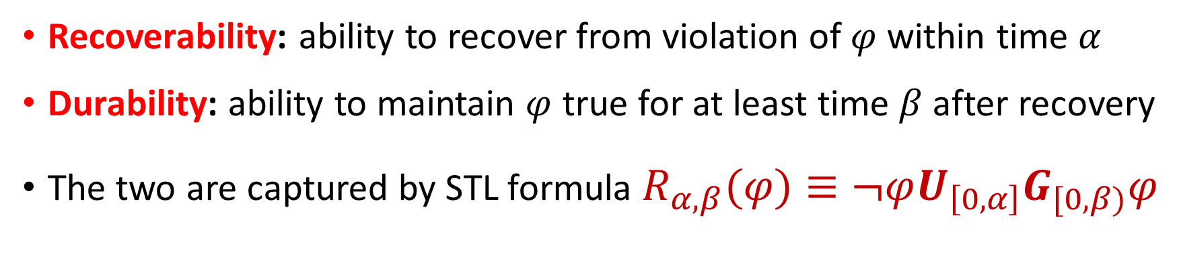
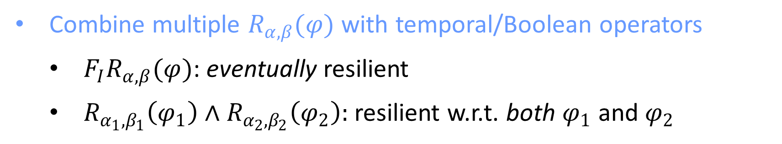
A Logical Characterization
Recoverability: ability to recover from violation of $φ$ within time $α$
Durability: ability to maintain $φ$ true for at least time $β$ after recovery
The two are captured by STL formula $R_{α,β}(φ)≡¬φU_{\left[0,α\right]}G_{[0,β)}φ$
Combine multiple $R_{α,β}(φ)$ with temporal/Boolean operators
  $F_{I}R_{α,β}(φ)$: eventually resilient
  $R_{α_{1},β_{1}}\left(φ_{1}\right)∧R_{α_{2},β_{2}}\left(φ_{2}\right):$ resilient w.r.t. both $φ_{1}$ and $φ_{2}$
Notes:
We want to characterize these two requirements from a logical perspective.
And we found that they are captured by the STL formula
Not phi holds until always phi holds where until is bounded by interval [0,alpha] and always is bounded by [0,beta)
We also want to combine multiple R-expressions to express specifications such as
Eventually resilient and resilient wrt to two properties at the same time

Slide 17
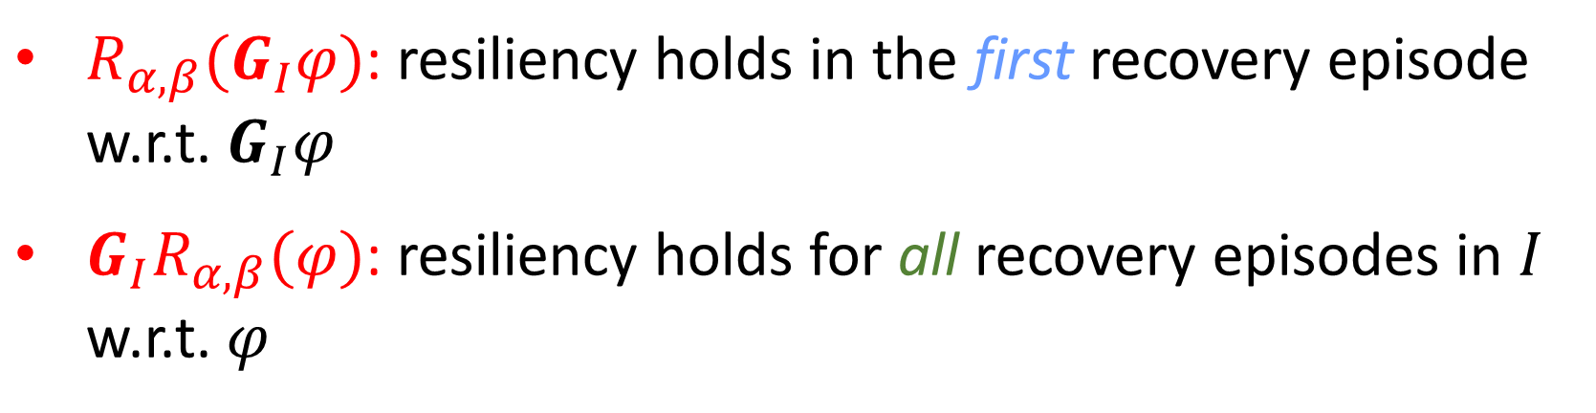
SRS: An STL-based Resiliency Specification Language
$ψ ∷=R_{α,β}(φ) \left| ¬ψ \right| ψ_{1}∨ψ_{2} \left| ψ_{1}∧ψ_{2} \right| ψ_{1}U_{I}ψ_{2}$
Why a new logic that composes $R$-expressions?
$R_{α,β}(G_{I}φ)$: resiliency holds in the first recovery episode w.r.t. $G_{I}φ$
${G_{I}R}_{α,β}(φ)$: resiliency holds for all recovery episodes in $I$ w.r.t. $φ$
Notes:
With the R-expressions and the requirements for combing them with temporal and Boolean operators, we propose the formal grammar of our new logic.
One might ask why we define a new logic that composes R-expressions?
The answer is we need the composite formulas to express something different to the atomic cases.
For example, the R-expression of globally phi requires the resiliency holds in the first recovery episode wrt globally phi.
And the composite formula Globally R-expression phi requires the resiliency holds for all recovery episodes in I wrt phi.

Slide 18
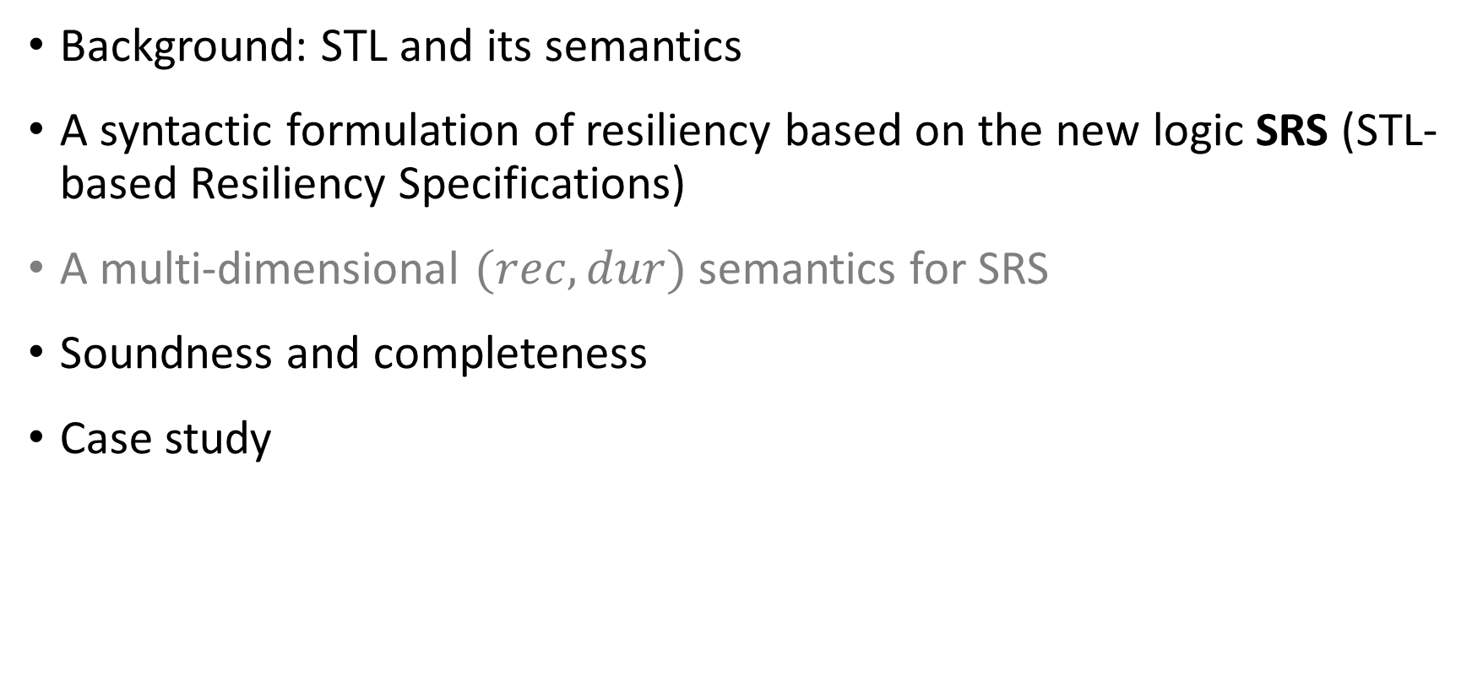
Presentation Outline
Background: STL and its semantics
A syntactic formulation of resiliency based on the new logic SRS (STL-based Resiliency Specifications)
A multi-dimensional $(rec,dur)$ semantics for SRS
Soundness and completeness
Case study
Notes:
Next, we discuss the semantics for this new logic

Slide 19


Towards a Quantitative Resiliency Semantics
Challenge: compare resiliency of two signals
Good recoverability, but bad durability
Good durability, but bad recoverability
Which of the two signals is more resilient?
Notes:
Before we go into the semantics definition.
under the assumption that recoverability and durability are equally important, a question is that when one signal has better recoverability but worse durability than another, which signal is more resilient?

Slide 20
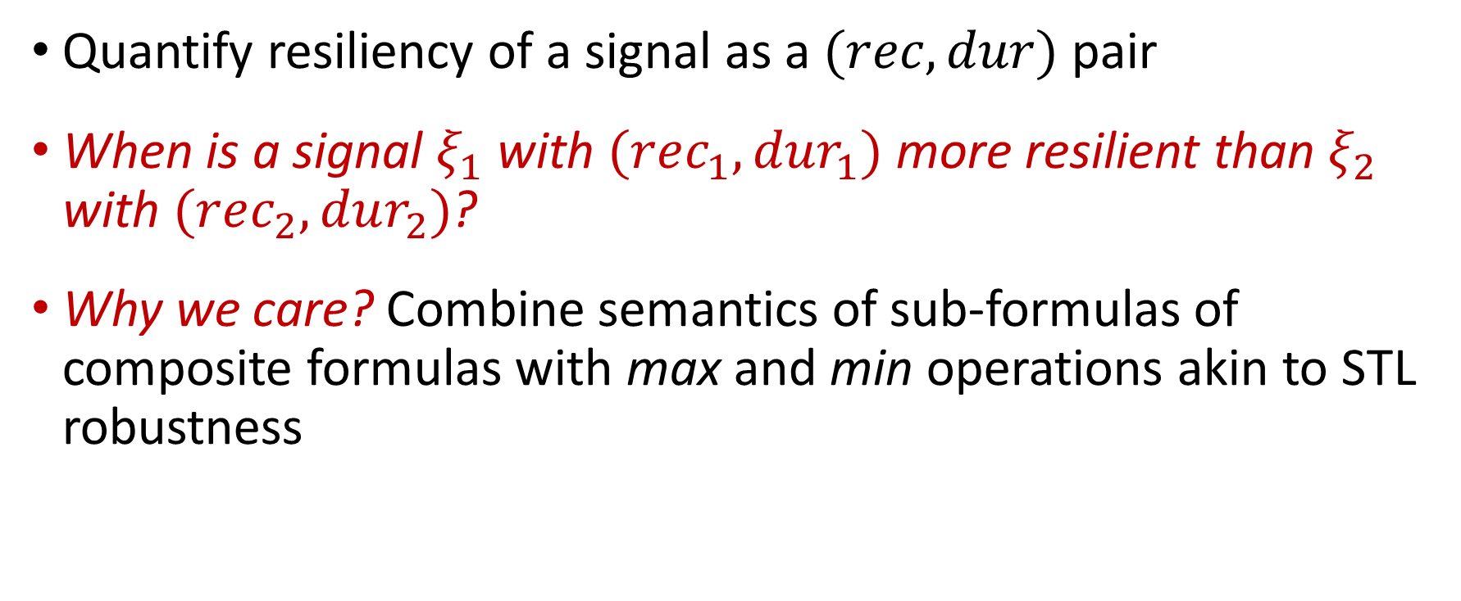
Towards a Quantitative Resiliency Semantics
Quantify resiliency of a signal as a $(rec,dur)$ pair
When is a signal $ξ_{1}$ with $(rec_{1},dur_{1})$ more resilient than $ξ_{2}$ with $(rec_{2},dur_{2})$?
Why we care? Combine semantics of sub-formulas of composite formulas with max and min operations akin to STL robustness
Notes:
We first quantify resiliency of a signal as a rec, dur pair
Then the question becomes when is a signal with $(rec_{1},dur_{1})$ more resilient than another signal with $(rec_{2},dur_{2})$?
The motivation for this question is that
When we define semantics for composite formulas, we need to combine semantics of sub-formulas with max and min operations similar to STL robustness

Slide 21
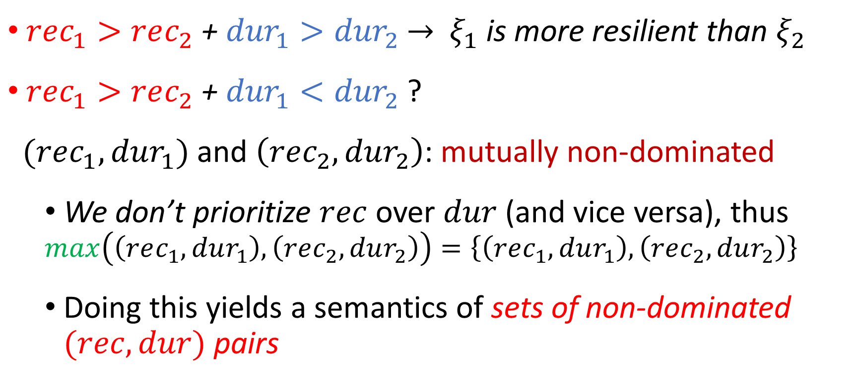
Towards a Quantitative Resiliency Semantics
$rec_{1}>rec_{2}$ + ${dur}_{1}>{dur}_{2}$ $→$ $ξ_{1}$ is more resilient than $ξ_{2}$
$rec_{1}>rec_{2}$ + ${dur}_{1}<{dur}_{2}$ ?
$(rec_{1},dur_{1})$ and $\left(rec_{2},dur_{2}\right)$: mutually non-dominated
  We don’t prioritize $rec$ over $dur$ (and vice versa), thus
  $$\max\left(\left(rec_{1},dur_{1}\right),\left(rec_{2},dur_{2}\right)\right)=\left\{\left(rec_{1},dur_{1}\right),\left(rec_{2},dur_{2}\right)\right\}$$
  Doing this yields a semantics of sets of non-dominated $(rec,dur)$ pairs
Notes:
In the simple case where rec_1 is greater than rec_2, and dur_1 is greater than dur_2. The answer is ksai 1 is more resilient.
What if rec_1 is greater than rec_2 but dur_1 is less than dur_2?
Our answer is they are mutually non-dominated, and two signals are equally resilient.
We do not prioritize one over the other, so finding the maximum between two pairs results in a set of both.
Eventually, doing this yields a semantics of sets of non-dominated pairs.

Slide 22
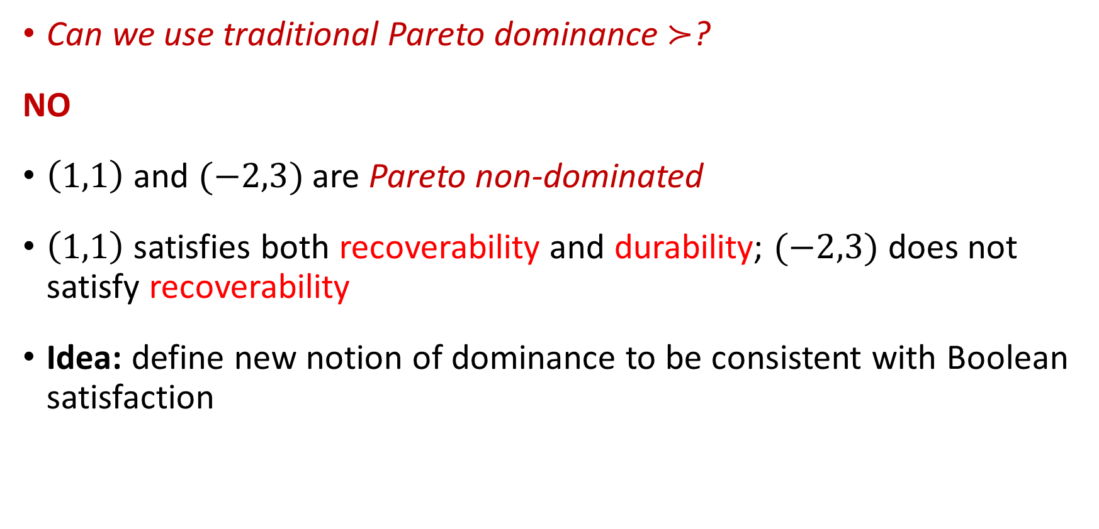
Towards a Quantitative Resiliency Semantics
Can we use traditional Pareto dominance $≻$?
NO
$\left(1,1\right)$ and $(−2,3)$ are Pareto non-dominated
$\left(1,1\right)$satisfies both recoverability and durability; $(−2,3)$ does not satisfy recoverability
Idea: define new notion of dominance to be consistent with Boolean satisfaction
Notes:
Can we use the traditional pareto dominance to describe their relations?
Our answer is no.
In an example where (1,1) and (-2,3) are pareto non-dominated.
(1,1) should be strictly better than (-2,3) because only (1,1) satisfies both recoverability and durability.
so, a good idea is to define new notion of dominance to be consistent with Boolean satisfaction

Slide 23


New Notion of Dominance: $≻_{re}$
$x=\left(x_{1},x_{2}\right) ≻_{re} y=(y_{1},y_{2})$ if
  $sign\left(x_{1}\right)+sign\left(x_{2}\right)>sign\left(y_{1}\right)+sign(y_{2})$
  $\left(1,1\right)≻_{re}(−2,3)$
  $sign\left(x_{1}\right)+sign\left(x_{2}\right)=sign\left(y_{1}\right)+sign(y_{2})$ and $x≻y$
  $(2,3)$ $≻_{re}\left(1,1\right)$
Notes:
We define a new notion of dominance
A pair dominates another if its sum of signs are greater than the other. Which means the signal satisfies more requirements than the other.
For example, (1,1) dominates (-2,3)
A pair can also dominate another if it pareto dominates the other even though their sums of signs are the same.
For example, (2,3) dominates (1,1)

Slide 24
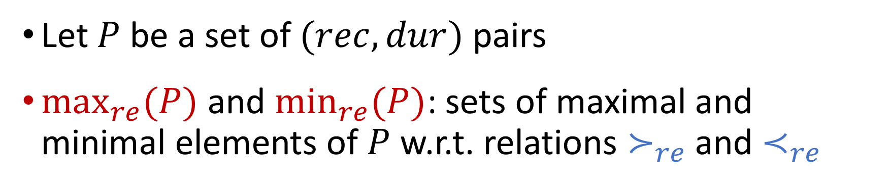
Maximum and Minimum Resilience Sets
Let $P$ be a set of $(rec,dur)$ pairs
$\max_{re}(P)$and $\min_{re}(P)$: sets of maximal and minimal elements of $P$ w.r.t. relations $≻_{re}$ and $≺_{re}$
Notes:
Then we define maximum and minimum resilience sets
Let P be a set of (rec,dur) pairs.
Max_re(P) and min_re(P) are the sets of maximal and minimal elements of P wrt relations dominate and being dominated.
In order word, they contains pairs corresponding to the most and least resilient signals respectively.

Slide 25
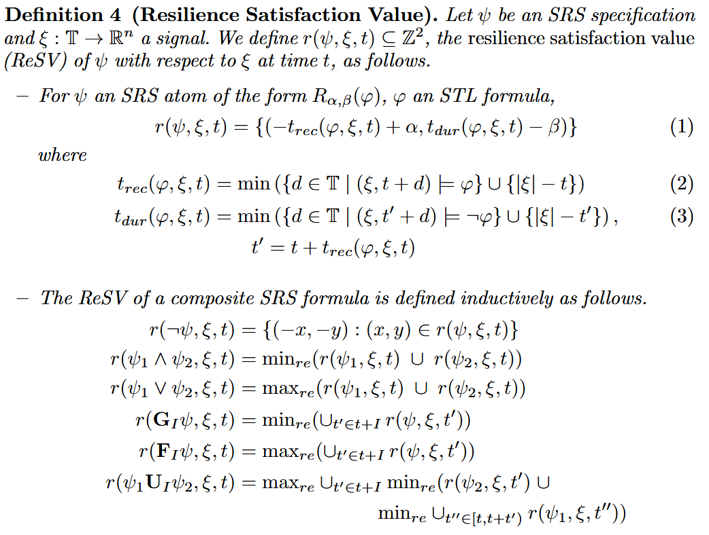
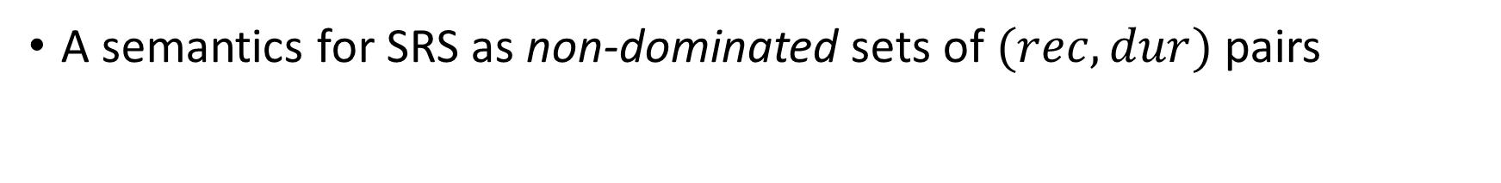
ReSV (Resilience Satisfaction Value)
A semantics for SRS as non-dominated sets of $(rec,dur)$ pairs
Notes:
We formally define the semantics called resilience satisfaction value (ResV).
In the atomic case, the semantics is a singleton set containing a pair measuring the signal ksai’s satisfaction of recoverability and durability.

Slide 26
ReSV (Resilience Satisfaction Value)
A semantics for SRS as non-dominated sets of $(rec,dur)$ pairs
Notes:
In the composite cases, like STL robustness, where $ρ$ values are combined with max and min
We use the maximum and minimum resilience sets to produce non-dominated sets instead of unique values

Slide 27
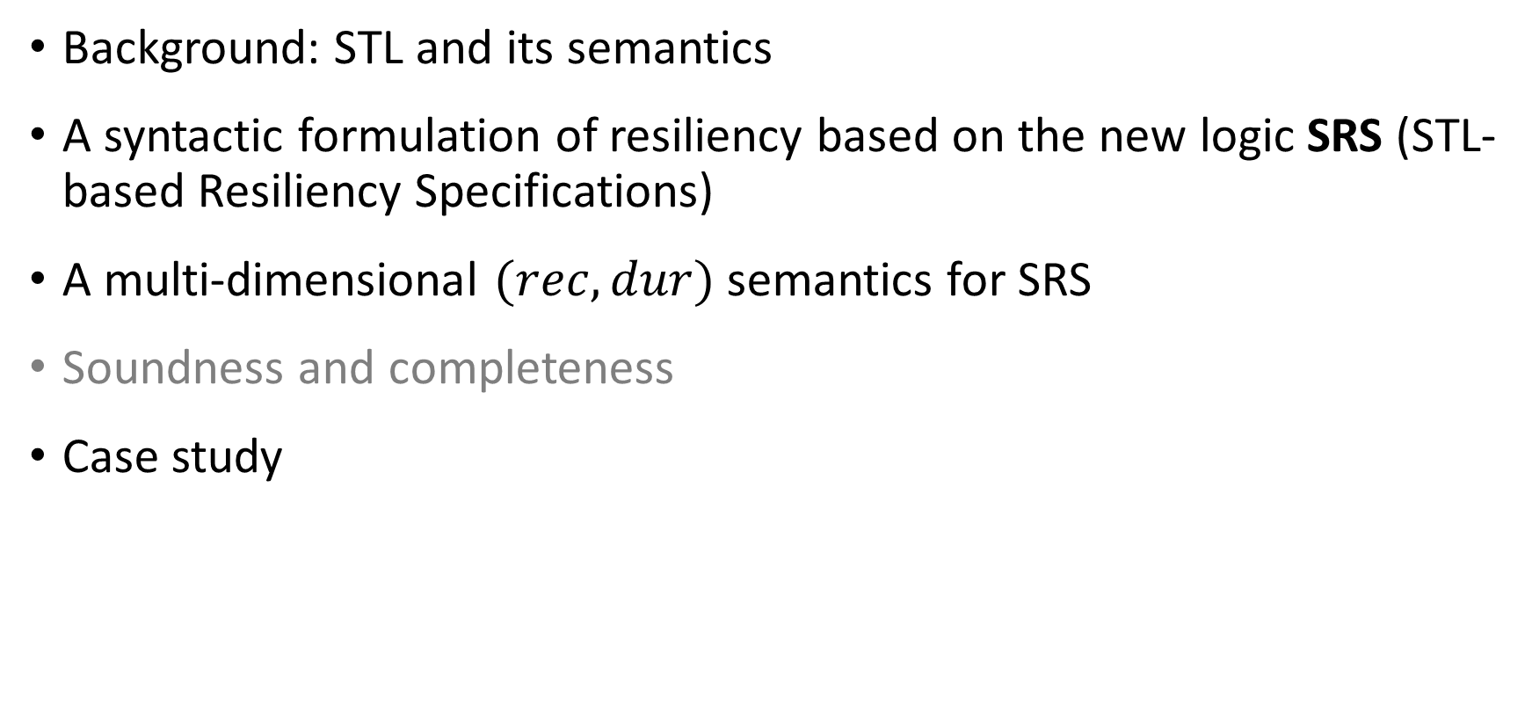
Presentation Outline
Background: STL and its semantics
A syntactic formulation of resiliency based on the new logic SRS (STL-based Resiliency Specifications)
A multi-dimensional $(rec,dur)$ semantics for SRS
Soundness and completeness
Case study
Notes:
Next, we explore the soundness and completeness of SRS semantics

Slide 28
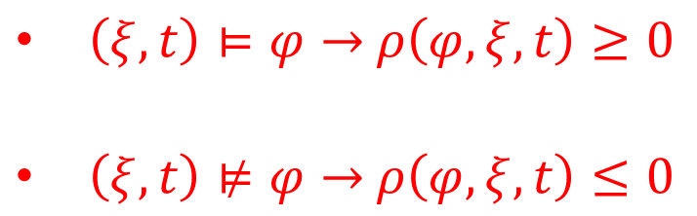
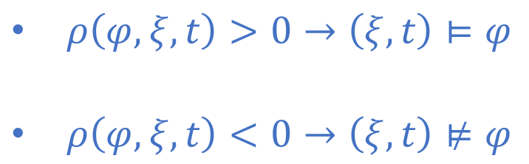
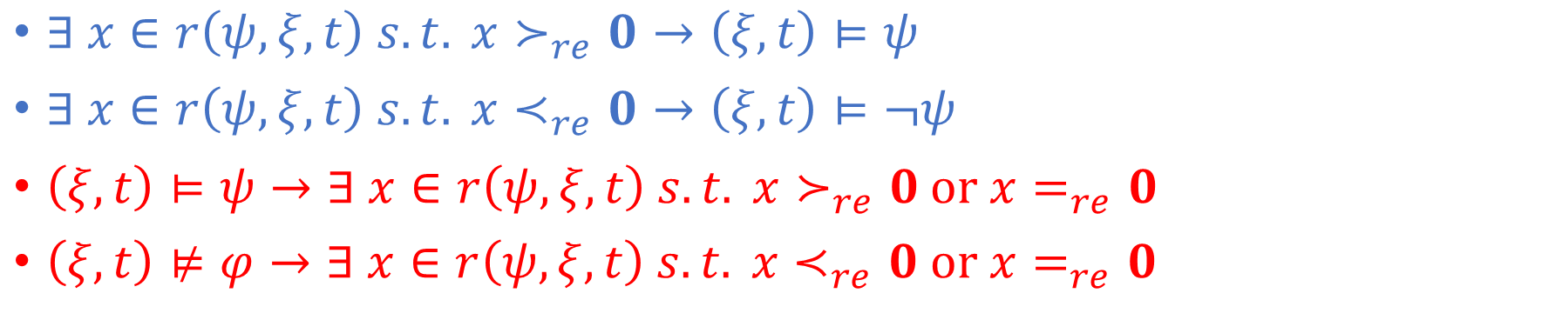
Soundness and Completeness of ReSV
$∃ x∈r\left(ψ,ξ,t\right) s.t. x≻_{re}0→\left(ξ,t\right)⊨ψ$
$∃ x∈r\left(ψ,ξ,t\right) s.t. x≺_{re}0→\left(ξ,t\right)⊨¬ψ$
$\left(ξ,t\right)⊨ψ→∃ x∈r\left(ψ,ξ,t\right) s.t. x≻_{re}0$ or $x=_{re}0$
$\left(ξ,t\right)⊭φ→∃ x∈r\left(ψ,ξ,t\right) s.t. x≺_{re}0$ or $x=_{re}0$
As in STL robustness $ρ$, our semantics is consistent w.r.t. Boolean interpretation
$ρ\left(φ,ξ,t\right)>0→\left(ξ,t\right)⊨φ$
$ρ\left(φ,ξ,t\right)<0→\left(ξ,t\right)⊭φ$
$\left(ξ,t\right)⊨φ→$ $ρ\left(φ,ξ,t\right)≥0$
$\left(ξ,t\right)⊭φ→$ $ρ\left(φ,ξ,t\right)≤0$
Notes:
We prove the soundness and completeness of our semantics
The quantities in the Resv set can be used in the Boolean sense similar to the soundness and completeness of STL robustness.
%For example , the existence of a pair that dominates (0,0) indicates the satisfaction of the SRS formula.

Slide 29
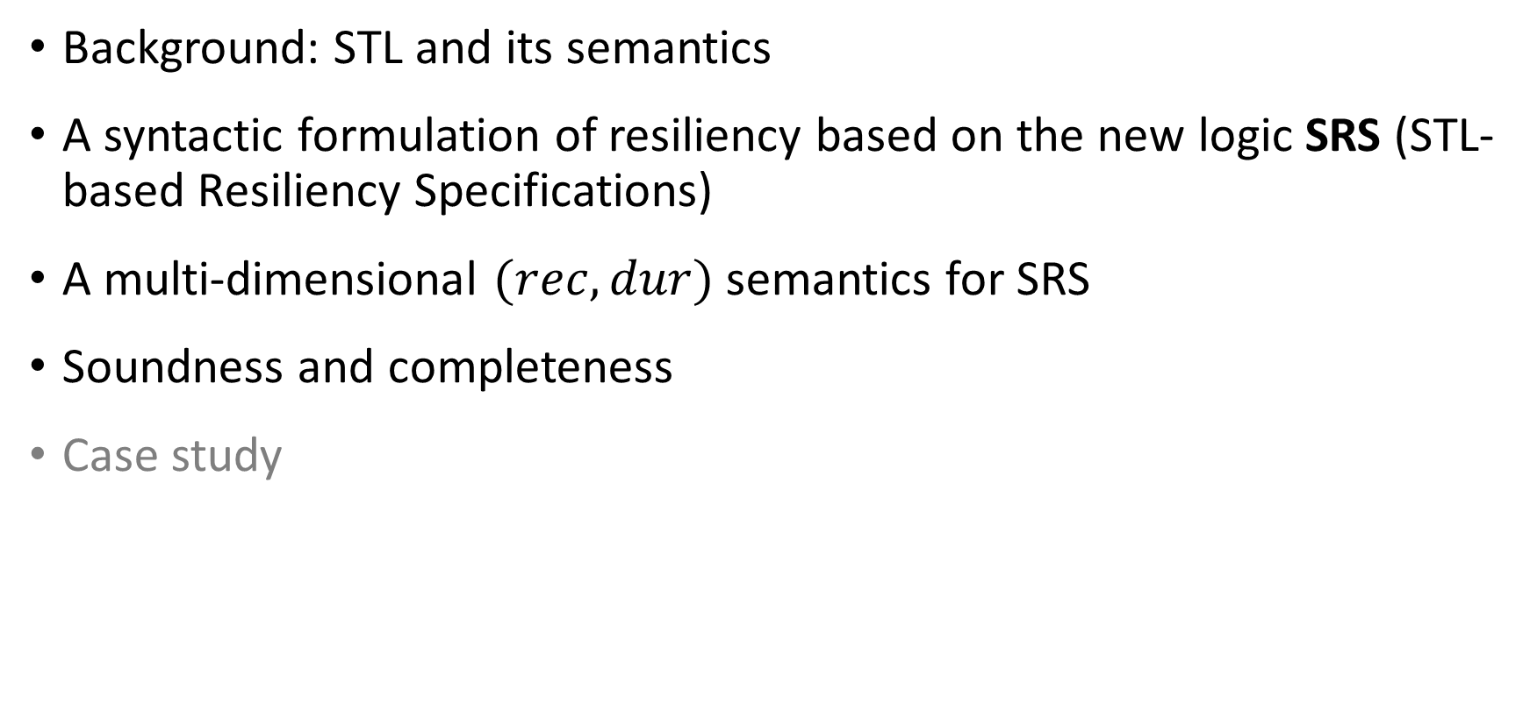
Presentation Outline
Background: STL and its semantics
A syntactic formulation of resiliency based on the new logic SRS (STL-based Resiliency Specifications)
A multi-dimensional $(rec,dur)$ semantics for SRS
Soundness and completeness
Case study
Notes:
Last, we demonstrate the utility of our SRS logic and ReSV semantics on a case study

Slide 30
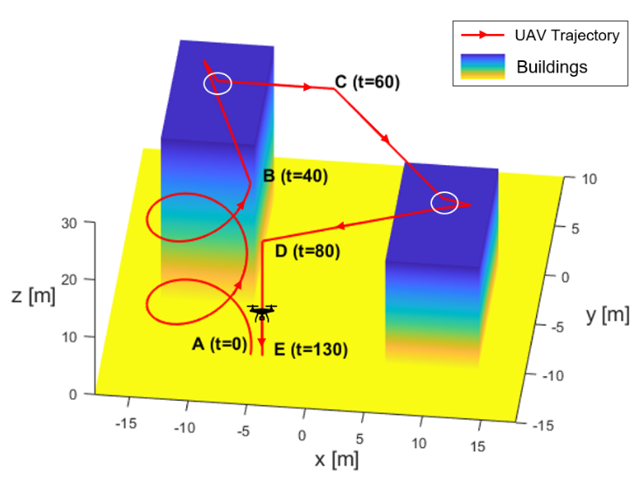
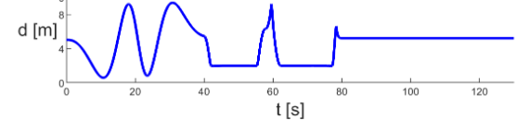
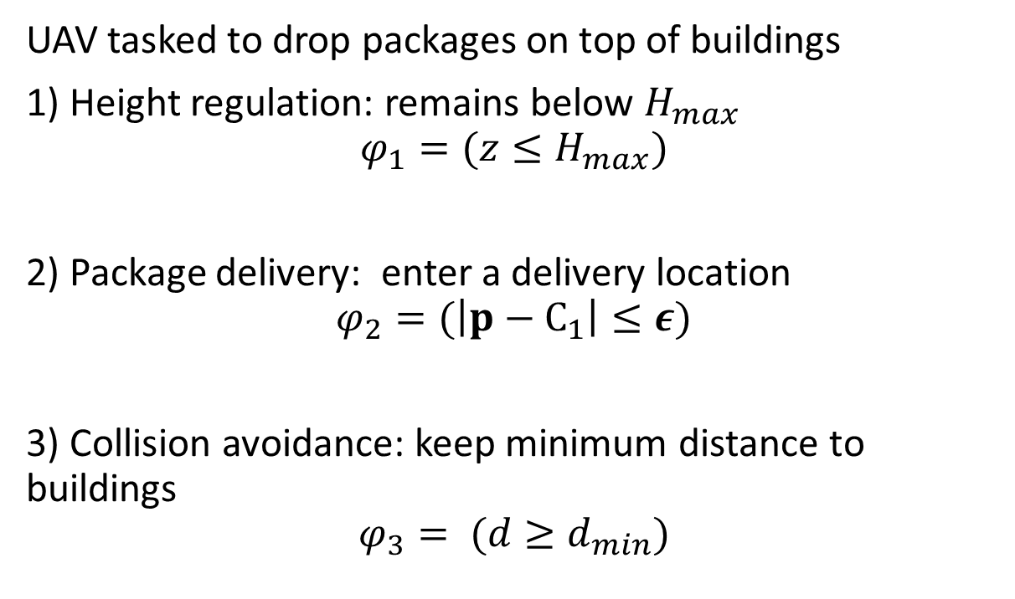
Case study – UAV package delivery
UAV tasked to drop packages on top of buildings
1) Height regulation: remains below $H_{max}$
$$φ_{1}=(z≤H_{max})$$
2) Package delivery: enter a delivery location
$$φ_{2}=(\left|p−C_{1}\right|≤ε)$$
3) Collision avoidance: keep minimum distance to buildings
$$φ_{3}= (d≥d_{min})$$
Notes:
We consider an UAV package delivery mission where the UAV needs to drop off packages on the rooftops of buildings
The properties for the UAV contain
Height regulation that restrict the maximum height allowed for the UAV
Package delivery at a certain location to drop the package
and collision avoidance that request minimum distance to the buildings.

Slide 31
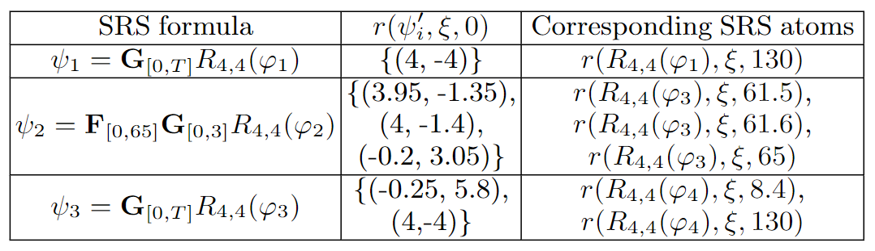
Case Study – UAV Package Delivery
Notes:
We formulate SRS formulas to express different resiliency requirements for above properties for the UAV.
For example, psi_1 describes the globally resiliency in the whole trajectory for the height regulation property. The time bounds for recoverability and durability are both set to be 4.

Slide 32
Case Study – UAV Package Delivery
Notes:
Psi_2 describes the requirement for the best-case resiliency episodes (due to the outermost F operator) in time interval 0,65 of the ReSV of the worst cases episodes (due to the inner G operator) in the subsequent interval [0,3].
It requires the Resiliency of the package delivery property, \phi_2 to be finally true for a period of time.

Slide 33
Case Study – UAV Package Delivery
Notes:
Because of the outermost G operator in psi_1, (4, −4) represents the worst-case recovery episode (relative to the STL property phi_1) within the interval [0, T ], meaning that (4, −4)
is dominated by every other (rec, dur ) pair in [0, T ]. The pair comes from the SRS atomic formula at time 130.

Slide 34
Case Study – UAV Package Delivery
Notes:
The pairs in the RESV of psi_2 constitutes a non-dominated set. They reflect the overall resiliency of the UAV package-delivery mission.
For example, the first pair indicates at time 61.5, the recoverability of phi_2 is satisfied but the durability is not.

Slide 35
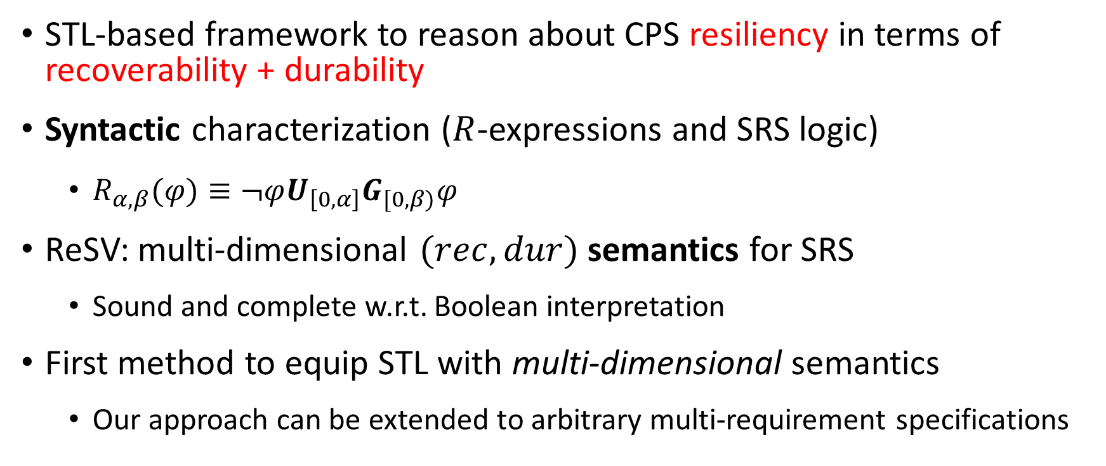
Conclusion
STL-based framework to reason about CPS resiliency in terms of recoverability + durability
Syntactic characterization ($R$-expressions and SRS logic)
  $R_{α,β}(φ)≡¬φU_{\left[0,α\right]}G_{[0,β)}φ$
ReSV: multi-dimensional $(rec,dur)$ semantics for SRS
  Sound and complete w.r.t. Boolean interpretation
First method to equip STL with multi-dimensional semantics
  Our approach can be extended to arbitrary multi-requirement specifications
Notes:
To conclude our presentation, we established an STL-based framework to reason about CPS resiliency in terms of recoverability and durability.
We provide syntactic characterization and a multi-dimensional semantics for our logic, SRS.
And it is the first STL-based multi-dimensional semantics which can be extended to arbitrary multi-requirement specifications.

Slide 36
References
[Bartocci18] Bartocci, Ezio, et al. "Specification-based monitoring of cyber-physical systems: a survey on theory, tools and applications." Lectures on Runtime Verification, 2018. 135-175.
[Cook10] Cook, Byron, et al. "Proving stabilization of biological systems." International Workshop on Verification, Model Checking, and Abstract Interpretation, 2011.
[Donze10] Donzé, Alexandre, and Oded Maler. "Robust satisfaction of temporal logic over real-valued signals." International Conference on Formal Modeling and Analysis of Timed Systems, 2010.
[Maler04] Maler, Oded, and Dejan Nickovic. "Monitoring temporal properties of continuous signals." Formal Techniques, Modelling and Analysis of Timed and Fault-Tolerant Systems, 2004. 152-166.
[Aksaray21] Aksaray, D.: Resilient satisfaction of persistent and safety specifications by autonomous systems. In: AIAA Scitech 2021 Forum. pp. 1124–1134 (Jan 2021).
[Bouvier21] Bouvier, J., Xu, K., Ornik, M.: Quantitative resilience of linear driftless systems. In: Proceedings of the Conference on Control and its Applications. pp. 32–39. SIAM (Jul 2021).
[Zhu11] Zhu, Q., Başar, T.: Robust and resilient control design for cyber-physical systems with an application to power systems. In: Proceedings of IEEE Conference on Decision and Control and European Control Conference. pp. 4066–4071. IEEE (Dec 2011).

Slide 37




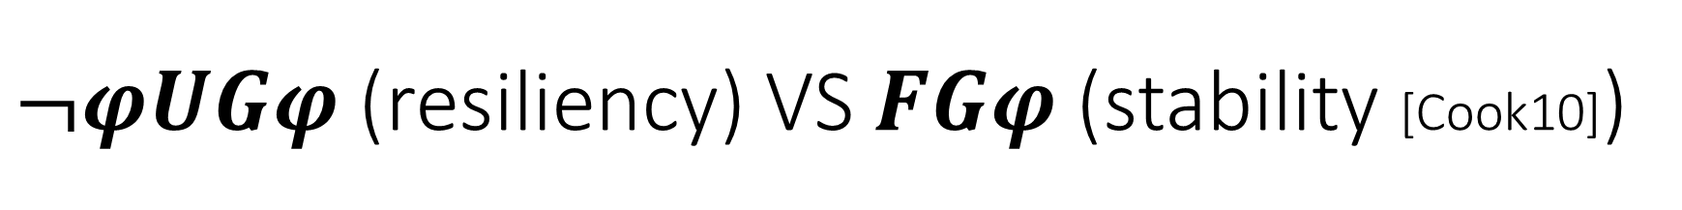

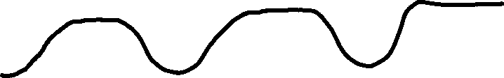


$¬φUGφ$ (resiliency) VS $FGφ$ (stability [Cook10])
There can be multiple recovery episodes in a signal
$F_{[0,α]}G_{[0,β)}φ$ is satisfied by any recovery episode
  I.e., by any $t∈[0,α]$ at which $G_{[0,β)}φ$ holds
$$α$$
$$φ=ξ≥0$$
$$β$$
$$β$$
$$β$$

Slide 38

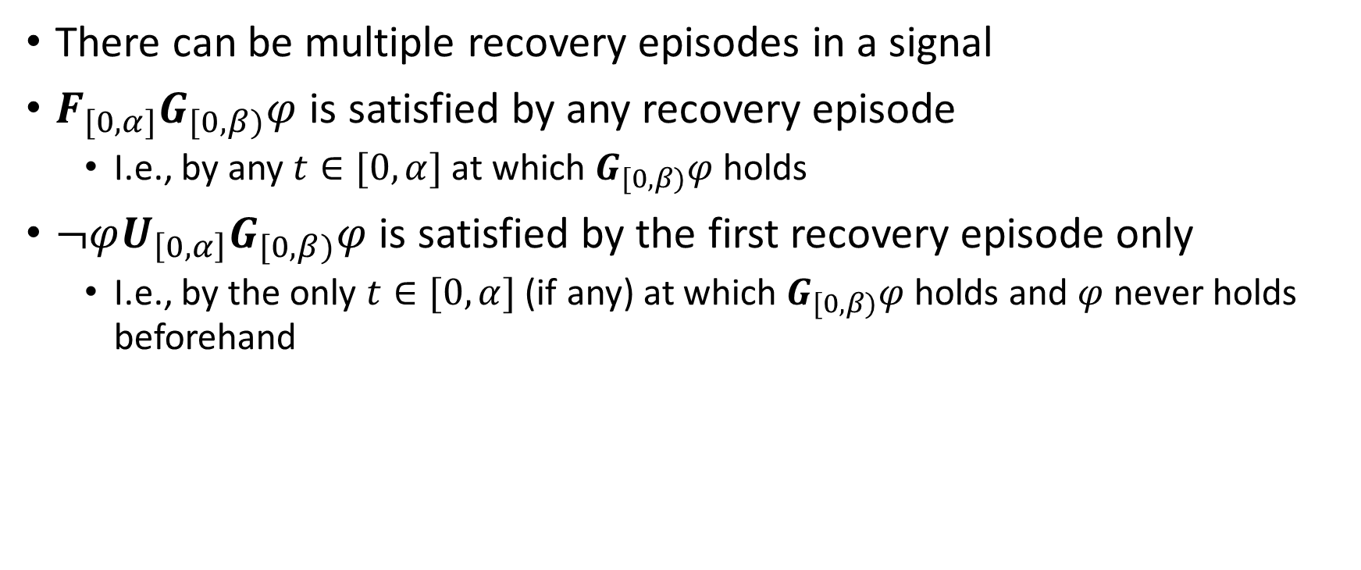
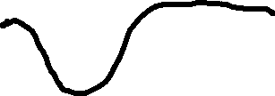
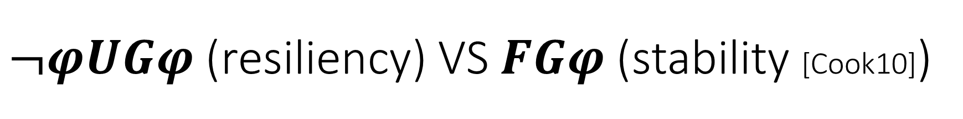
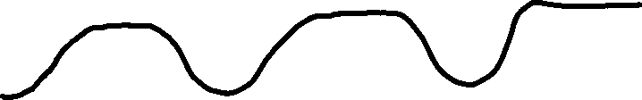


$¬φUGφ$ (resiliency) VS $FGφ$ (stability [Cook10])
There can be multiple recovery episodes in a signal
$F_{[0,α]}G_{[0,β)}φ$ is satisfied by any recovery episode
  I.e., by any $t∈[0,α]$ at which $G_{[0,β)}φ$ holds
$¬φU_{\left[0,α\right]}G_{[0,β)}φ$ is satisfied by the first recovery episode only
  I.e., by the only $t∈[0,α]$ (if any) at which $G_{[0,β)}φ$ holds and $φ$ never holds beforehand
$$α$$
$$φ=ξ≥0$$
$$β$$

Slide 39
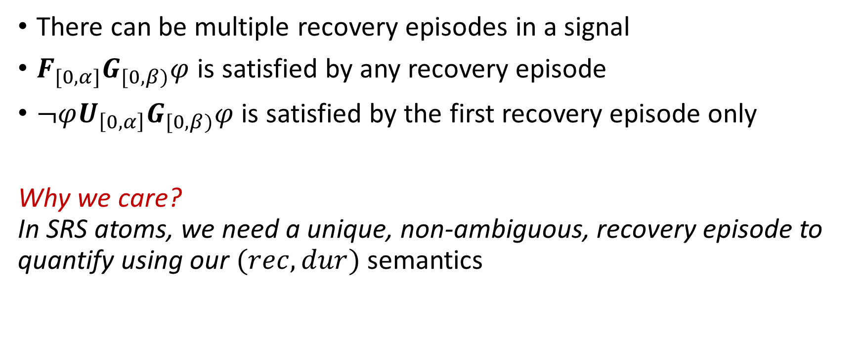
$¬φUGφ$ (resiliency) VS $FGφ$ (stability [Cook10])
There can be multiple recovery episodes in a signal
$F_{[0,α]}G_{[0,β)}φ$ is satisfied by any recovery episode
$¬φU_{\left[0,α\right]}G_{[0,β)}φ$ is satisfied by the first recovery episode only
Why we care?
In SRS atoms, we need a unique, non-ambiguous, recovery episode to quantify using our $(rec,dur)$ semantics

Slide 40
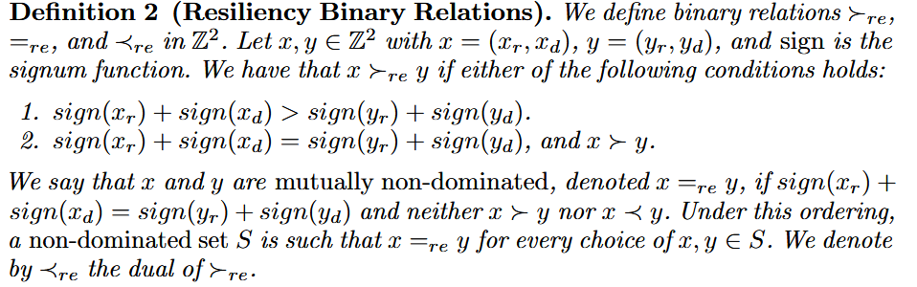
Dominance

Slide 41
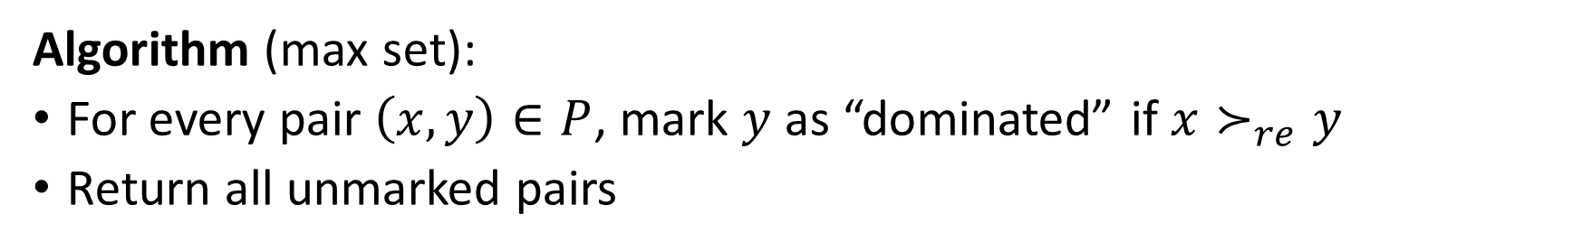
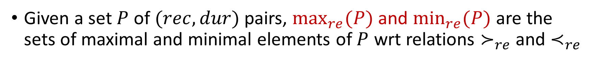
Max and min resilience sets
Given a set $P$ of $(rec,dur)$ pairs, $\max_{re}(P)$and $\min_{re}(P)$are the sets of maximal and minimal elements of $P$ wrt relations $≻_{re}$ and $≺_{re}$
Algorithm (max set):
For every pair $\left(x,y\right)∈P$, mark $y$ as “dominated” if ${x≻}_{re}y$
Return all unmarked pairs
Notes:
Let’s do a quick exercise if there is time
Algorithm is same as brute force Pareto front

Slide 42


Example
Consider the SRS formula
$ψ=G_{\left[0,20\right]}R_{1,2}(x>0)$
Then, $r(ψ,x,0)$ is
I.e., we extract all the $(rec,dur)$ pairs (w.r.t. $R_{1,2}(x>0)$) within interval $[0,20]$ and take the minimum set (wrt $≺_{re}$)
Notes:
Say formula in natural language

Slide 43

Example
Notes:
Say formula in natural language

Slide 44

ReSV and Boolean satisfiability
Thus, if $x≻_{re}0$ for some $x∈r(ψ,ξ,t)$, then $x≻_{re}0$ for all $x∈r(ψ,ξ,t)$
Notes:
We believe that this holds more strictly – say a bit more

