Slide 1

Toothbrushing Monitoring using Wrist Watch
Hua Huang, Shan Lin
Notes:
Thank you for the introduction. Our topic is toothbrushing monitoring using wrist watch. This is a joint work with my advisor Professor Shan Lin

Slide 2
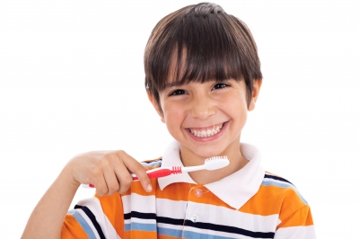

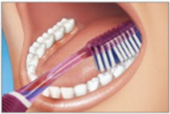
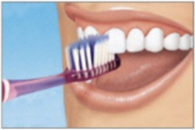
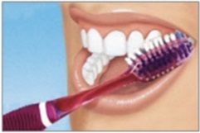
How long?
What Technique?
Users estimate:134s
In fact: 83s [1]
75% users failed
to brush correctly[2]
[1] U. Saxer, J. Barbakow, and S. Yankell, “New studies on estimated and actual toothbrushing times and dentifrice use.” The Journal of clinical dentistry, vol. 9, no. 2, pp. 49–51, 1997
[2] C. Ganss, N. Schlueter, S. Preiss, and J. Klimek, “Tooth brushing habits in uninstructed adults—frequency, technique, duration and force,” Clinical Oral Investigations, vol. 13, no. 2, pp. 203–208, 2008
Notes:
Toothbrushing is very important to our oral health. But do you know not everyone is doing it right?
The first question is brushing time. It is widely recommended that each toothbrushing session should be 2 minutes. However, a study shows that people on average over estimate brushing time by 50%
If estimating the overall brushing time is difficult, then estimating the coverage for each of the tooth surface is even more difficult. To ensure toothbrushing quality, it’s also important to brush each tooth surface for the correct amount of time.
And finally, the toothbrushing technique is also important. Common incorrect toothbrushing technique, such as back-forth horizontal brushing for the outer tooth surfaces could create 2 times more abrations. However, a study shows that 75% of the participants fail to brush using the correct technique.

Slide 3
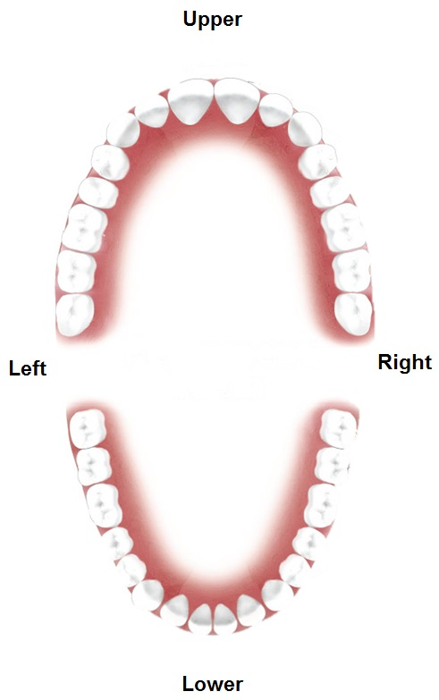
The 16 Tooth Surfaces
Notes:
This figure illustrates our teeth. In total, we have 16 tooth surfaces. We have upper teeth and lower teeth. We have outer surfaces and inner surfaces. For the back teeth, we also have chewing surfaces.

Slide 4
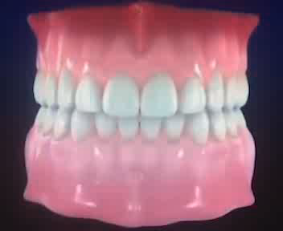
The Bass Toothbrushing Technique
The American Dental Association (ADA) recommends the Bass technique
Outer and Inner Surfaces
(10 surfaces)
Notes:
To brush our teeth, the american dental associationi recommends the bass technique. To brush the 10 outer and inner surfaces,
Click
We need to use gentle rolling motions to brush along the teeth.

Slide 5
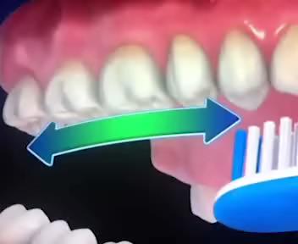
The Bass Toothbrushing Technique
Chewing Surfaces
4 surfaces
Notes:
To brush the 4 chewing surfaces, we need to use back-forth horizontal brushing strokes

Slide 6
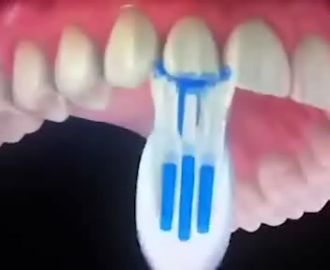
The Bass Toothbrushing Technique
Front Inner Surfaces:
2 Surfaces
Notes:
To brush the two front inner surfaces, we need to tilt the toothbrush and brush along the tooth

Slide 7
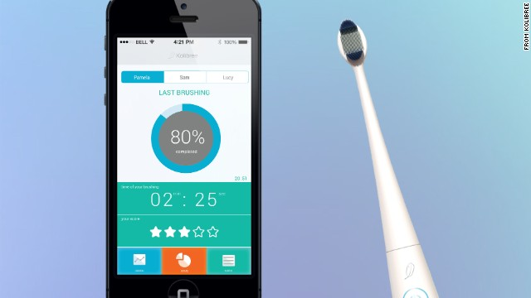
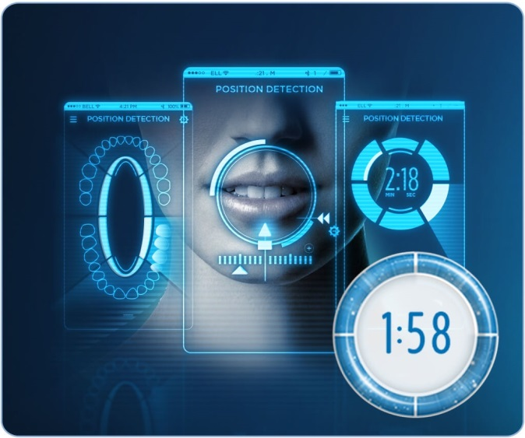
Current Monitoring Systems
Vision-based (Oral-B)
  YC Chang et al. Playful toothbrush: ubicomp technology for teaching tooth brushing to kindergarten children. CHI '08
Sensor-based(Philips, Kolibree)
  Y. J. Lee, et.al. Toothbrushing region detection using three-axis accelerometer and magnetic sensor. IEEE Transactions on Biomedical Engineering,2012.
Acoustic-based
  J. Korpela, et al.. Evaluating tooth brushing performance with smartphone sound data. UbiComp 2015
Notes:
A few toothbrushing monitoring systems are designed. There are computer vision based systems, which recognize toothbrushing gestures by tracking the user’s face and toothbrush in a video. However, currently such systems can only recognize one of the six sextants of the teeth because the images inside the mouth are unavailable.
Sensor-based systems are also designed. These systems generally have inertia sensors installed on the toothbrush, and recognize toothbrushing gestures based on motion sensor data. However, a draw back of such systems is that they fail to capture the complex mutual interaction between the toothbrush and the user’s hand during toothbrushing. As a result, currently the recognition precision is poor.
Acoustic based systems are also designed. These systems recognize toothbrushing surfaces based on the brushing sound recorded by the phones. However, these systems cannot recognize all 16 tooth surfaces because the brushing sound of some surfaces are the same.

Slide 8
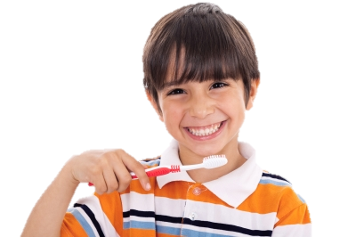
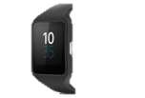
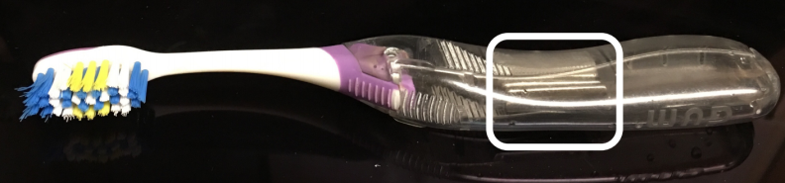
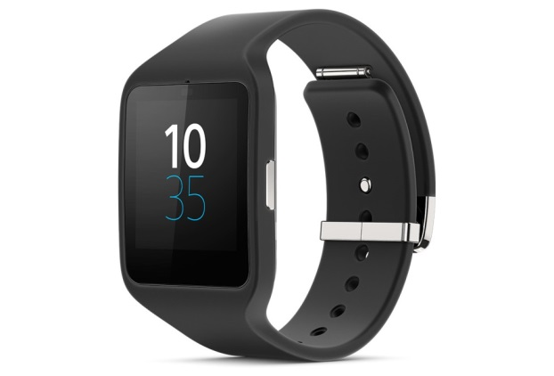
Solution Overview
Notes:
This is an overview of our toothbrushing monitoring system. In this sytem, there is a customized toothbrush, a smart watch, and a smart phone.

Slide 9
Solution Overview
Low cost
User friendly
Notes:
To enable the sensing of the toothbrush orientation and motion, we install magnets to the handle. This design is low cost. The magnet costs 7 cents each. It is also user friendly, because we can install the magnets inside the handle or design magnetic snap case.

Slide 10
Solution Overview
Arm
motion
Magnetic
field
Notes:
We use a smart watch to capture the magnetic field from the toothbrush, and the motions from the user’s arm. Based on this information, recognition algorithms are conducted to monitor the toothbrushing surface and technique.

Slide 11
Solution Overview
Feedback
Surface
Technique
Notes:
The recognition results are transmit to the smart phone, which will provide feedback on toothbrushing coverage for each surface and the toothbrushing technique to the user in real time
To support our system, we have also used cloud services for data storage, computation and user management

Slide 12
Contributions
A novel magnetic sensing technique to detect toothbrush orientation and motion
Construct gesture models to characterize the coupled motions of a user’s arm, wrist and hand based on inertial sensor data
Build a prototype toothbrushing monitoring system. In a 3 week experiment with 12 users, achieve 85.6% surface recognition precision
Notes:
To capture dynamic interactions between the toothbrush and the user’s hand, we attach small magnets
on off-the-shelf toothbrushes and design novel magnetic sensing algorithms to detect toothbrush orientation and motion.
We identify coupled motions of a user’s wrist, hand, and arm during toothbrushing with the Bass technique, and design models based on inertial sensing data to characterize toothbrushing gestures.
We build a toothbrushing monitoring system prototype using wrist watch. In a 3 week experiments with
12 users, our system successfully recognized the brushing gestures on 16 tooth surfaces with an average precision of 85.6%.

Slide 13
Related Work
Activity Recognition
  Handwashing
    V Galluzzi, et.al. Hand hygiene duration and technique recognition using wrist-worn sensors. IPSN ‘15
  Smoking
    A Parate, et.al. Risq: Recognizing smoking gestures with inertial sensors on a wristband. MobiSys '14
  Eating
    R. I. Ramos-Garcia, et.al. A Study of Temporal Action Sequencing During Consumption of a Meal. BCB’13
Notes:
Many smart watch based activity recognition systems have been designed.
For example, hand washing, smoking and eating activities are monitored using smart watches. These works provide valuable insights on how to recognize daily human activities.
Compared with these activities, toothbrushing is different because the motions of a hand tool, the toothbrush, play an important role in the activity. Therefore, we propose a novel magnetic sensing technique to capture such motions.

Slide 14
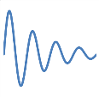
System Design
Toothbrush Motion, Orientation Features
Magnetometer
Magnetic
Sensing Model
Recognition
Algorithm
Toothbrush Sensing
Bayes-based
Classification
Current Surface
Arm Gesture Sensing
Brushing
Gesture Model
Toothbrushing
Order
Accelerometer,
Gyroscope
Arm Motion Features
Notes:
Now I will introduce our system design. There are three components: the Toothbrush sensing module, the arm gesture sensing module, and the recognition algorithm module

Slide 15
System Design (Sensing Toothbrush)
Toothbrush Motion, Orientation Features
Magnetometer
Magnetic
Sensing Model
Bayes-based
Classification
Current Surface
Brushing
Gesture Model
Toothbrushing
Order
Accelerometer,
Gyroscope
Arm Motion Features
Notes:
We will begin with the toothbrush sensing module.

Slide 16
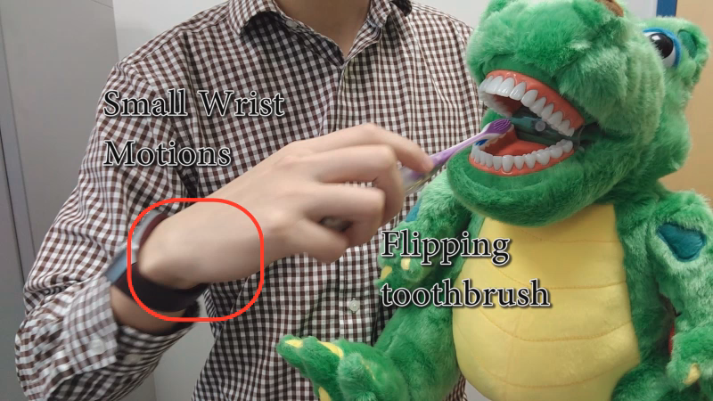
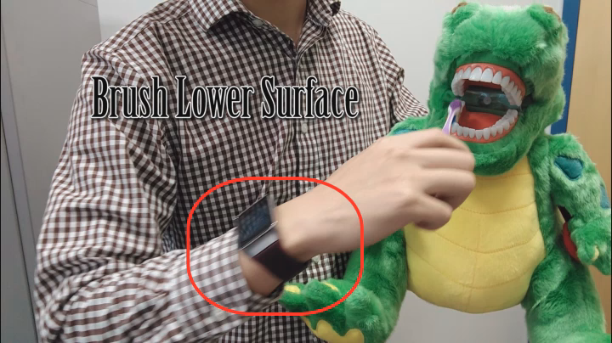
Challenge: How to sense the toothbrush?
Motions cannot indicate the surface being brushed
Notes:
There are many previous works on recognizing smart watch motions.
However, in the following two examples, we show that in the context of toothbrushing monitoring, smartwatch motions cannot indicate the surface being brush.
The first example is about brushing different surfaces with identical motions.
(play)
We can see that when the user is brushing the lower surface (wait ) and brushing the upper surface (wait), the motion of the arm is the same. Therefore, we cannot distinguish them using motions sensors alone. The only difference is the toothbrush orientation
The second example is about subtle finger motions that are too small to be captured by the watch.
(play)
In this video, the user is rotating the toothbrush using finger. We can hardly see any smart watch motions.
Therefore, it’s important to design new techniques to toothbrush orientations and motions.

Slide 17
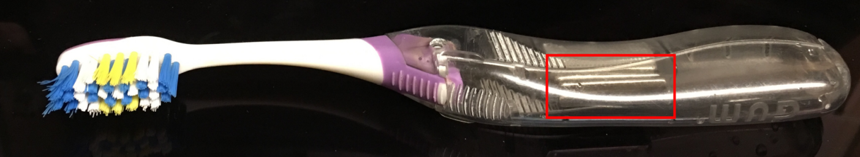
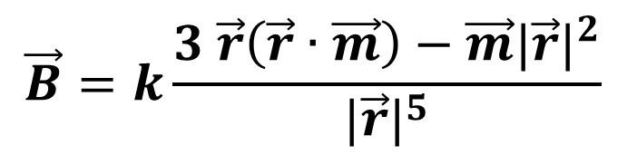


A Novel Magnetic Sensing Technique
Install a magnet on toothbrush
Low cost (~7 cents)
User friendly (inside the handle, snap case)
$$\vec{B}=k\frac{3 \vec{r}\left(\vec{r}∙\vec{m}\right)−\vec{m}{|\vec{r}|}^{2}}{{|\vec{r}|}^{5}}$$
$\vec{r}:$Magnet position
$\vec{m}:$Magnet orientation
Notes:
Our solution is to install magnets on the toothbrush handle, and use magnetic sensor to capture the magnetic field.
(click)
This design is low cost. The magnet costs 7 cents each. It is also user friendly, because we can install the magnet inside the toothbrush handle, or design a magnetic snap case.
(click)
The magnetic field, B, can be calculated by this equation. In this equation, vector r represents the relative position of the magnet, and vector m represents the orientation of the magnet.
Based on this equation, we can estimate the toothbrush orientation and angle of rotation of the toothbrush

Slide 18
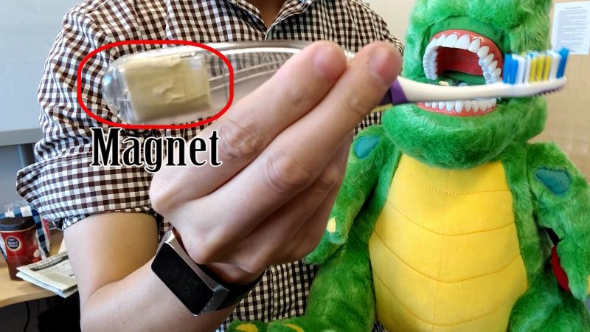

Detect Toothbrush Orientations
Brush with 4 different toothbrush orientations
Record the magnetic sensing results $B$
Notes:
Next we test whether or not our design can be used to detect toothbrush orientation. In this experiment, We brush the teeth with 4 different toothbrush orientations, and record the magnetic sensor readings
(play)
We can see that the toothbrush is facing left, facing down, facing right, facing up. Each time the toothbrush changes orientation, the magnetic sensing results change significantly.
Therefore, we can use the magnetic sensing result to estimate the toothbrush orientation

Slide 19
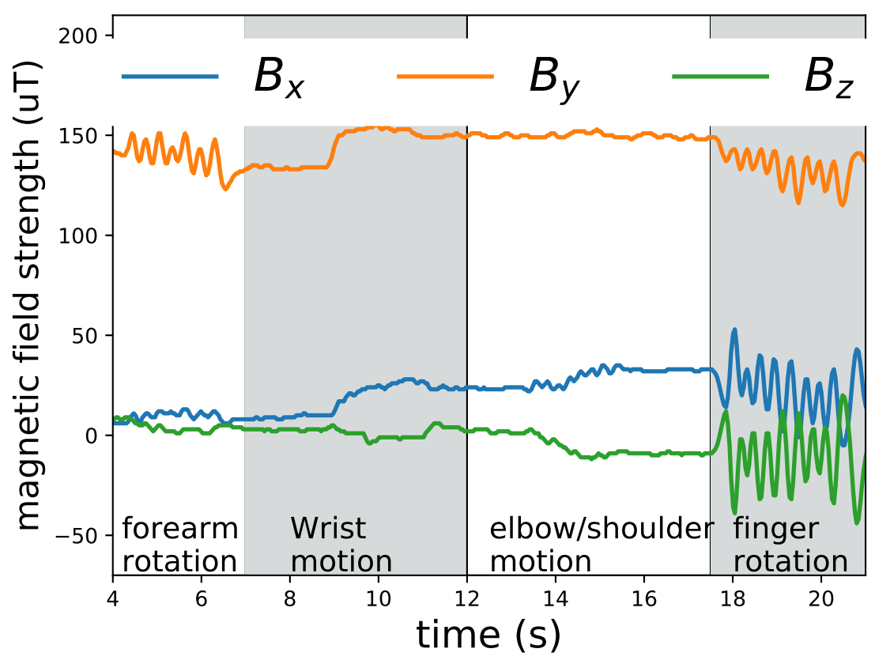
Detect Toothbrush Motions
Periodic fluctuation,
rotate toothbrush using finger
Notes:
Next we show the magnetic sensing results when the toothbrush is used differently. In the red box, we can see that when the user is rotating the toothbrush with fingers, the magnetic sensing value fluctuates periodically according to the rotating frequency. This is different from when the user is brushing with forearm rotation, wrist motion, and elbow motion. Therefore, we can extract the range of fluctuation and zero crossing rate of the magnetic field as a feature to indicate the existence of toothbrush motion

Slide 20
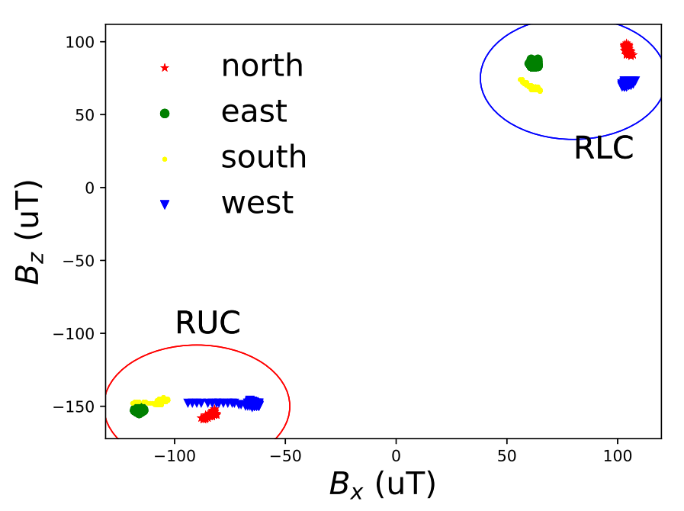
Robustness to Geomagnetic Field
Magnetic Field Reading
Lower
Surface
Upper
Surface
Notes:
We also test the robustness of our system to the influence of geomagnetic field. In this experiment, with the four different cardinal directions, the user brushes the upper teeth and lower teeth.
From this figure, we can see that no matter what cardinal direction the user faces, when the lower teeth are brushed, the magnetic sensing data are clustered in the blue circle in the upper right corner. When the upper teeth are brushed, the magnetic sensing data are clustered in the red circle in the lower left corner. This means that our system can still distinguish upper or lower toothbrush orientations.
Nevertheless, we can see different cardinal direction can create a noticeable influence on the magnetic sensor reading.

Slide 21
System Design (Sensing Brushing Gesture)
Toothbrush
Orientation, Motion
Magnetometer
Magnetic
Sensing Model
Bayes-based
Classification
Current Surface
Accelerometer,
Gyroscope
Brushing
Gesture Model
Arm Motion Features
Notes:
Next we will introduce the toothbrushing gesture sensing module

Slide 22
Understanding Brushing Gestures
Challenge: multiple motions are involved
Observations: Each gesture is a unique combination of three types of basic motions
  Forearm Rotation
  Should/Elbow Flexion/Extraction
  Wrist Flexion/Extraction
Strategy: model and recognize each basic motion type and their combinations
Notes:
We focus on sensing the motions involved in the Bass technique. It is a complex process that involves motions.
Click
Our observation is that each toothbrushing gesture is a unique combination of one or more basic motion types. These basic motion types are forearm rotation, elbow/shoulder flexion/extraction and wrist flexion/extraction
Click
This motivates us to construct models and design features to recognize each of these motions and their combinations.

Slide 23
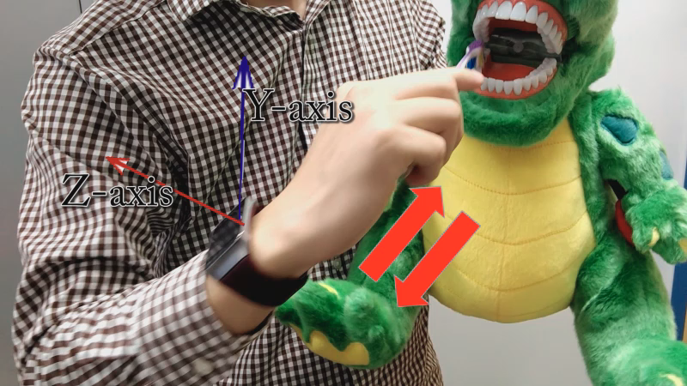
Recognizing Elbow/Shoulder Motions
Notes:
The elbow shoulder motion is involved when the user is brushing the chewing surfaces. An example is shown in this video.
The

Slide 24
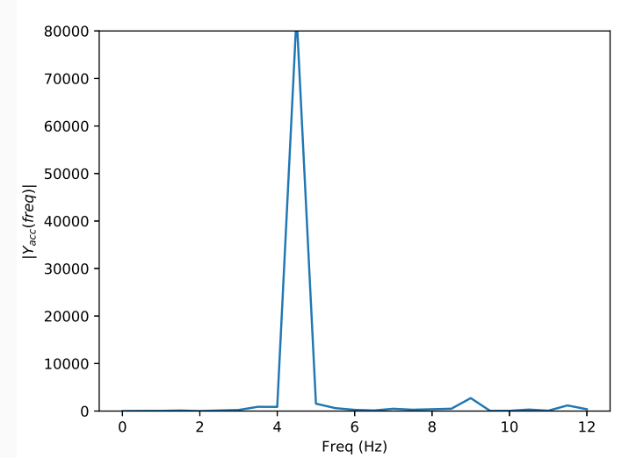
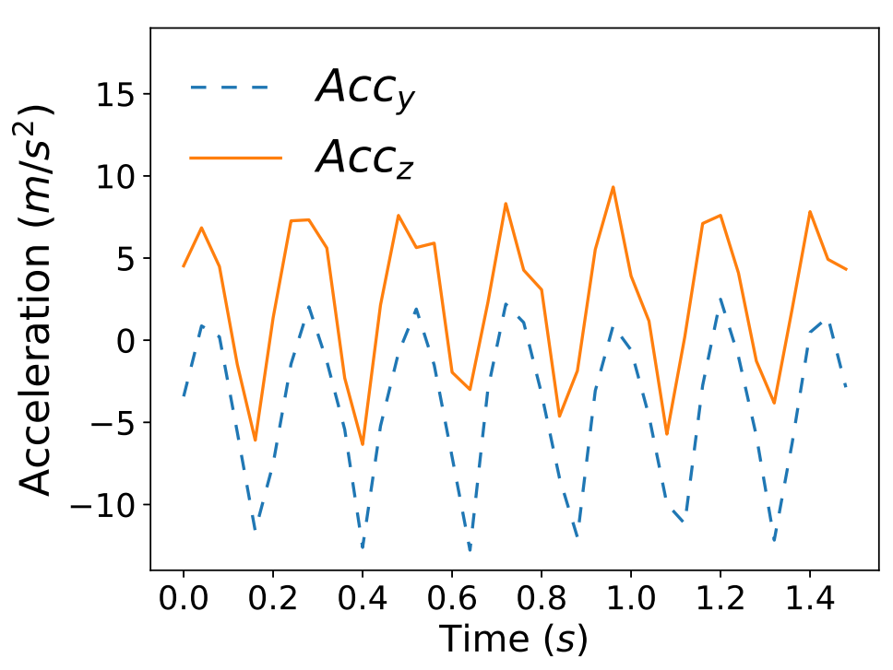
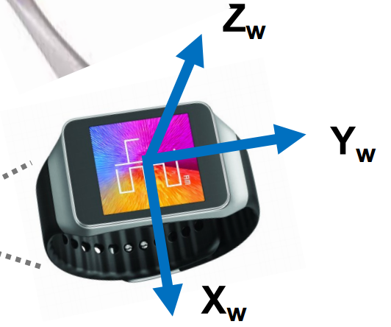

Recognizing Elbow/Shoulder Motions
Highly periodic
Reflected in power spectrum $|Y_{acc}|$
Notes:
The accelerometer reading of the elbow shoulder reading is shown in the figure on the left. The directions of the y and z axes are illustrated in the figure on the right. We can see that the sensor data are highly periodic. The sensor value has one peak and one valley in each brushing stroke. This motivates us to study the frequency response of the sensor data.
Click
The power spectrum of the accelerometer data is shown in this figure. We can see that there is a large peak at about 4 Hz, which corresponds to the toothbrushing stroke frequency.
Therefore, we compute the power spectrum of the accelerometer reading and extract the peak power spectrum value and frequency as features to recognize this motion type

Slide 25
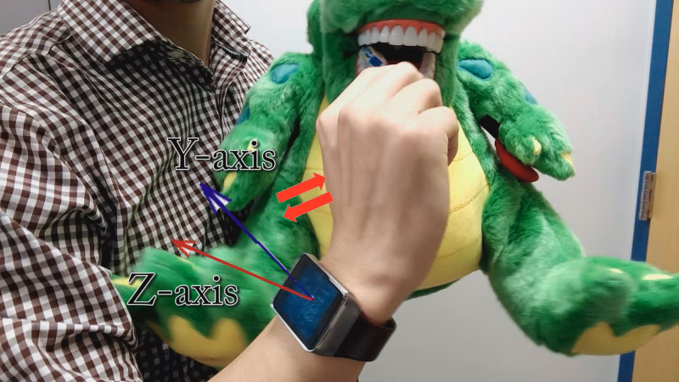
Recognizing Wrist Motions
Notes:
Next we study the recognition of wrist motions. Wrist motions are frequently involved in brushing of inner tooth surfaces. An example is shown in this video

Slide 26
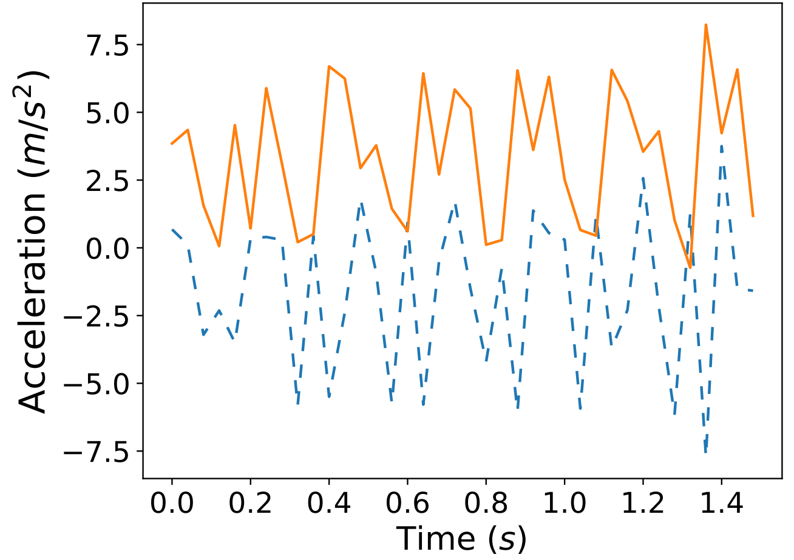
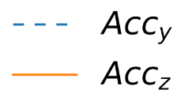

Recognizing Wrist Motions
Wrist Flexion/Extraction
  Negative correlation between ${acc}_{y}$ and ${acc}_{z}$
Notes:
A sample result of the accelerometer reading of the wrist motion is shown in this figure. We can see there is a negative correlation between acc_y and acc_z., which is different from the accelerometer reading for elbow motions. This motivates us to extract the correlation between the accelerometer readings as a feature to recognize wrist motions.

Slide 27
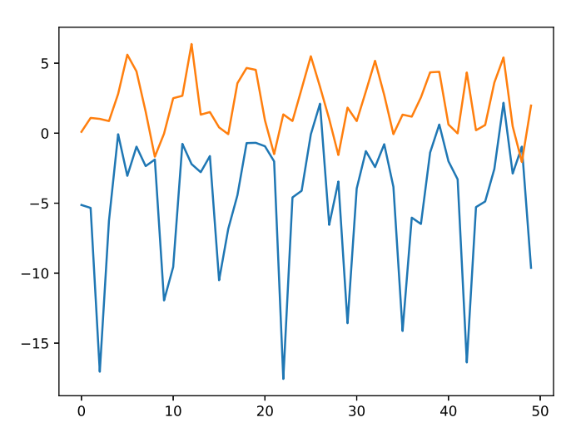
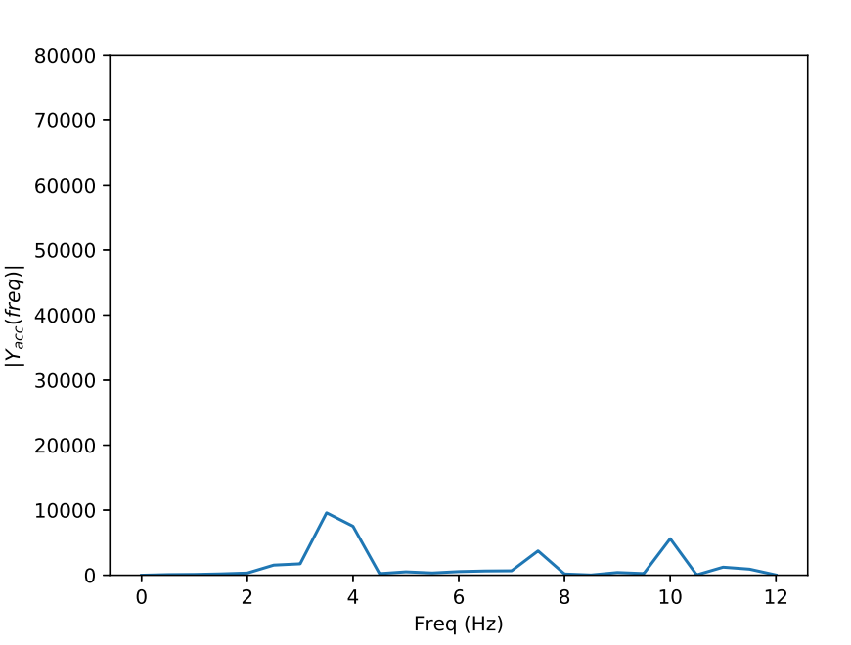
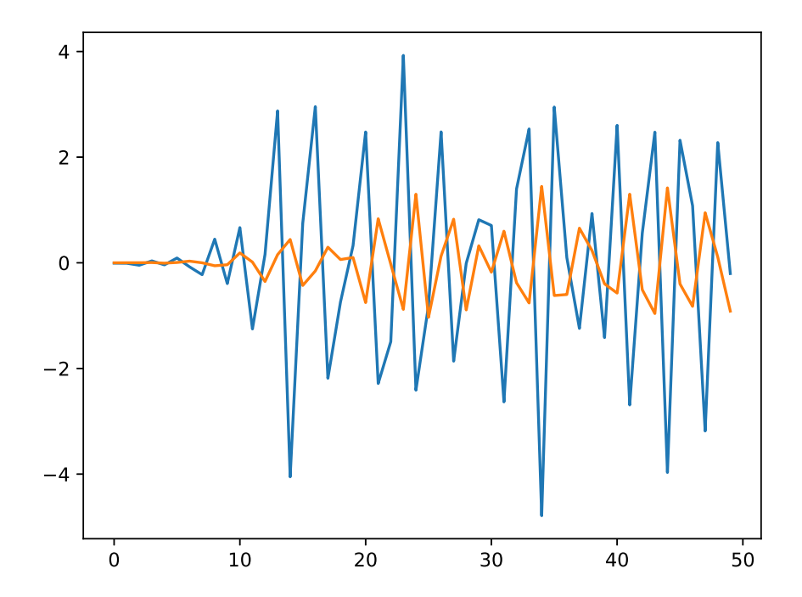

Recognizing Wrist Motions
Elbow motions and wrist motions occur simultaneously
Have different frequency response
Bandpass filter, then extract ${cor}_{yz}$
Left Lower Inner
Notes:
In many cases, elbow and wrist motions occur simultaneously. As we can see in this figure, we can see that the patterns are no longer clear.
In this case, we need to separate their influence. We find that there are two peaks corresponding to the elbow motions and wrist motions in the power spectrum. Therefore, we apply bandpass filters to separate influence from different motion types before extracting features.

Slide 28

Recognizing Forearm Rotation
Directly reflected by ${gyro}_{y}$
Use moving variance
Notes:
The recognition of forearm rotation is straight forward. We find that the forearm rotation is reflected the gyroscope sensor reading along y axis. Therefore, we use a moving variance to track the existence of this motion type.

Slide 29
Additional Motion Features
PCA-based Motion Direction
Moving average, variance and skewness
Notes:
We further extract additional features to improve recognition performance. The first one is the PCA-based motion direction feature, and other statistical features including moving average, variance and skewness.

Slide 30
System Design(Recognition Algorithm)
Toothbrush
Orientation, Motion
Magnetometer
Magnetic
Sensing Model
Bayes-based
Classification
Current Surface
Brushing
Gesture Model
Toothbrushing
Order
Accelerometer,
Gyroscope
Arm Motion Features
Notes:
After all the features are extracted, we use the recognition algorithm module to predict the most likely toothbrushing surface.

Slide 31
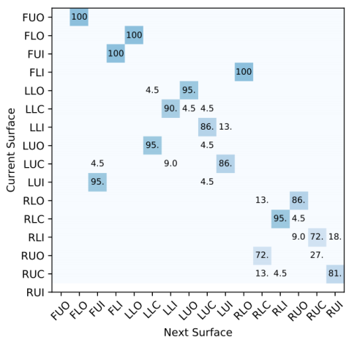

Recognition Algorithm
Surface | Probability
1 | 0.7
2 | 0.18
… | …
16 | 0
$$[f_{1},f_{2},…f_{n}]$$
Bayes
Inference
Hidden Markov
Current
Surface
All features
Surface₁
Surface₂
Surface₃
…
…
Toothbrushing Order
Surface₁₆
Notes:
After all the features are extracted, we firstly apply a Bayes algorithm to estimate the likelyhood of each of the 16 surfaces. We also construct a hidden markov model using the toothbrushing surface transition probability. Using a simple weighted sum algorithm, we combine the results of these two parts and make the final surface prediction.

Slide 32
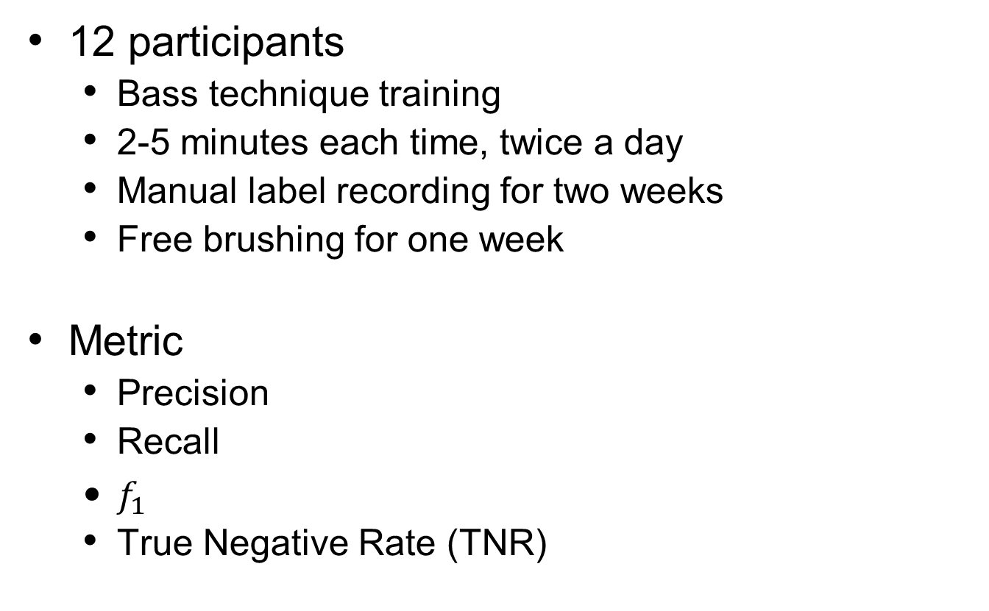
Evaluation (Experimental Setup)
12 participants
  Bass technique training
  2-5 minutes each time, twice a day
  Manual label recording for two weeks
  Free brushing for one week
Metric
  Precision
  Recall
  $f_{1}$
  True Negative Rate (TNR)
Notes:
We evaluated our system with 12 users. Before data collection, each user watched the Bass technique video and brushed once under the guidance of a dentist. Each toothbrushing session lasted 2 to 5 minutes, and the users brushed twice a day.
In the first two weeks, the users manually enter ground truth labels during toothbrushing. In third week, the users brush the teeth normally, and the grand truth label are collected by a second observer.

Slide 33
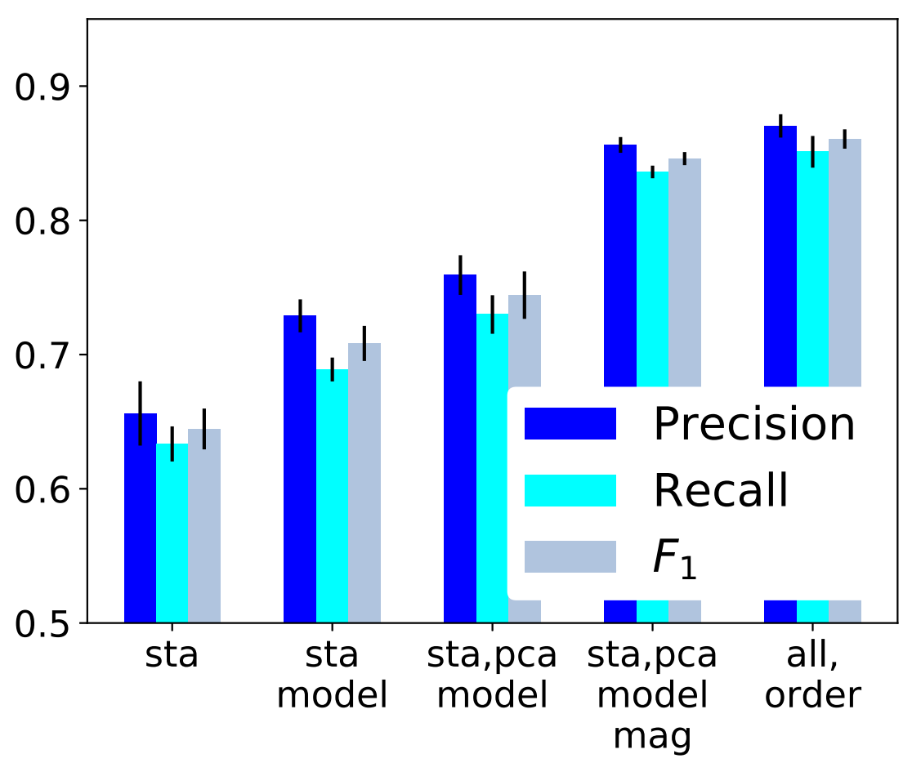
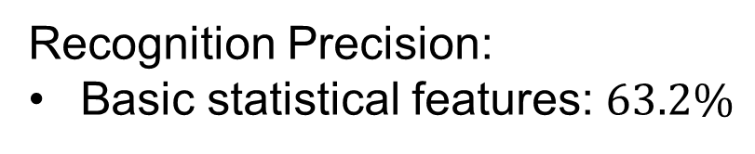
Recognition Precision:
Basic statistical features: $63.2\%$
Toothbrushing Surface Recognition Result
Notes:
We firstly introduce the surface recognition precision results. Recognition precision is defined as the ratio between true positive rate and true positive rate plus false positive rate.
In this figure, we can see that when only the basic statistical features are extracted, the surface recognition precision is 63.2%

Slide 34
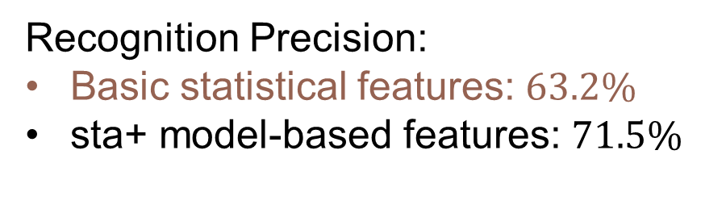
Recognition Precision:
Basic statistical features: $63.2\%$
sta+ model-based features: $71.5\%$
Toothbrushing Surface Recognition Result
Notes:
When the gesture model features are used, we achieve a 8% improvement in precision. .

Slide 35
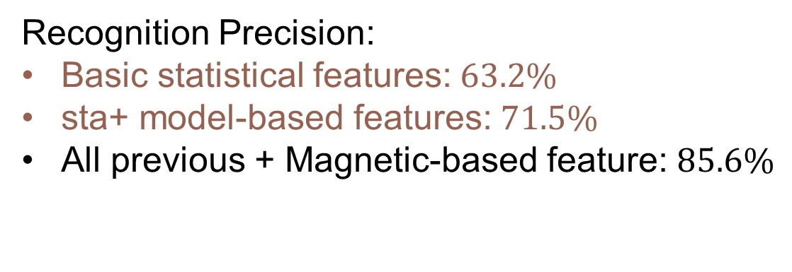
Recognition Precision:
Basic statistical features:$63.2\%$
sta+ model-based features:$71.5\%$
All previous + Magnetic-based feature: $85.6\%$
Toothbrushing Surface Recognition Result
Notes:
When we include the magnetic sensing feature, we further improve the recognition precision to 85.3%

Slide 36
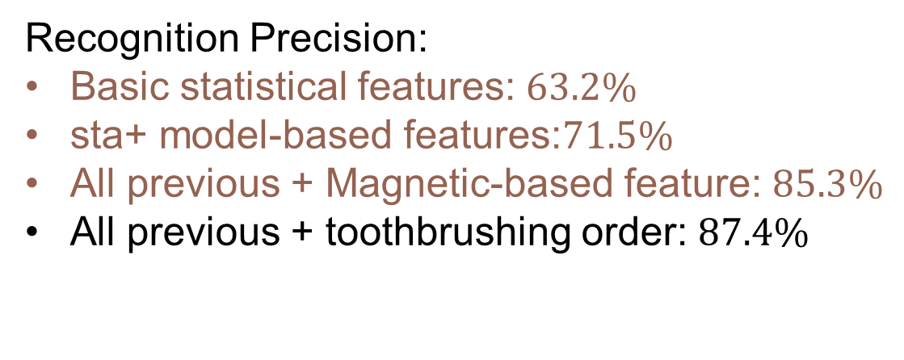
Recognition Precision:
Basic statistical features: $63.2\%$
sta+ model-based features:$71.5\%$
All previous + Magnetic-based feature: $85.3\%$
All previous + toothbrushing order: $87.4\%$
Toothbrushing Surface Recognition Result
Notes:
When we incorporate the user’s toothbrushing order information to the algorithm, we can slightly improve the precision by 2.1%

Slide 37
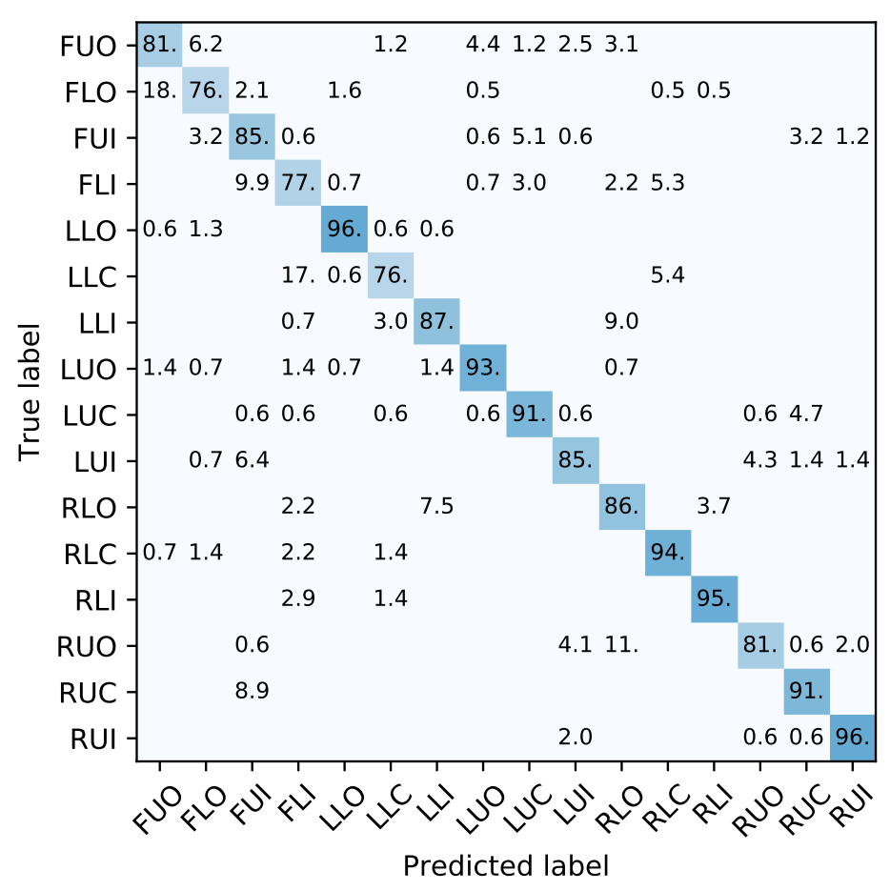
Confusion Matrix for Surface Recognition
Notes:
To better understand the performance of the algorithm, we also plot the confusion matrix. In this matrix, the y axis represents the ground true label, and the x axis represents the predicted label computed by our algorithm

Slide 38
Strength: able to distinguish upper or lower chewing surfaces
  Left Lower Chewing(LLC) and Left Upper Chewing(LUC)
  Same for RLC and RUC
0%
0.6%
Notes:
We can see that our system is able to distinguish upper and lower chewing surface. In this example, we can see that the confusion between the left lower chewing and left upper chewing is less than 1%

Slide 39
Strength: able to distinguish upper or lower chewing surfaces
Strength: recognize forearm rotation (Left Lower Outer) with high accuracy
96%
Notes:
Our algorithm is also effective in recognizing forearm rotation motions. For example, the surface of left lower outer surface is recognize with high precision

Slide 40
Strength: able to distinguish upper or lower chewing surfaces
Strength: recognize forearm rotation with high accuracy
Strength: Other complex surfaces
94%
95%
96%
Notes:
For some other surfaces that involve more than one motion type, our algorithm also has good performance. For example, our system is able to recognize left upper outer, right lower inner and right upper inner with high precision.

Slide 41
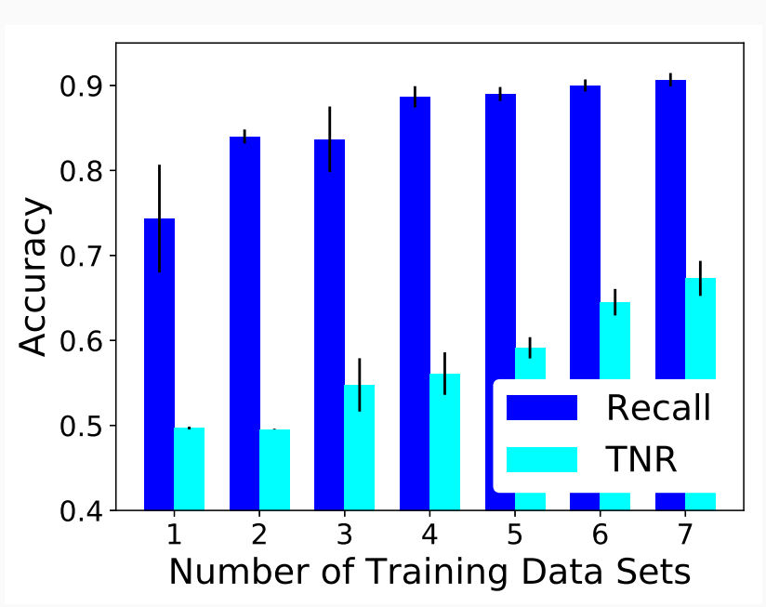
Incorrect Toothbrushing Techniques
Use the one-class SVM classifier
Train the algorithms using correct toothbrushing data
  Recall up to 90%
  True Negative Rate up to 66%
Notes:
We also tested whether our system can detect incorrect toothbrushing techniques. Specifically, we focus on the detection of brushing using horizontal strokes for the inner and outer surfaces.
We train a one-class svm classifier using only the correct toothbrushing sensor data. The detection results are shown in this figure.
To evaluate performance, we use the recall rate and true negative rate. Recall rate measures the system’s performance in recognizing correct toothbrushing technique, while true negative rate measures the system’s performance in recognizing incorrect toothbrushing
Our system achieves recall rate of up to 90%, and true negative rate up to 66%

Slide 42
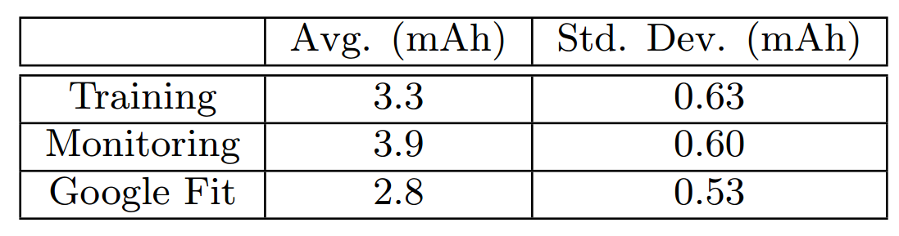
Impact on Battery Life
Watch battery capacity: 310 mAh
2 Min Energy Consumption
Notes:
We also tested our system’s impact on battery life. The smart watch model we use has 310mAh. We run our system for 2 minutes for 5 times, and we record the energy consumptions using the battery historian tool. We can see that on average, one toothbrushing monitoring session consumes 3.9 mAh. Since users typically brush for twice a day, our system consumes less than 5% of the battery storage a day.

Slide 43
Conclusion
A novel magnetic sensing technique to recognize toothbrush orientation and motion
Construct gesture models to recognize arm motions in toothbrushing.
Experimental results with 12 users for 3 weeks show the system achieved 85.6% of average surface recognition precision
Notes:
In conclusion, in this project, we have designed a novel magnetic sensing technique to recognize the orientation and motion of a hand tool, the toothbrush.
We have also constructed gesture models for the Bass toothbrushing technique to recognize the coupled motions of a user’s wrist, hand, and arm, and design models based on inertial sensing data to characterize toothbrushing gestures.
We build a toothbrushing monitoring system prototype using wrist watch. In a 3 week experiments with
12 users, our system successfully recognized the brushing gestures on 16 tooth surfaces with an average precision of 85.6%.

Slide 44
Thank you!

